Slide 1

Api Conference Online | April, 12 2021 | @nilshartmann
NILS HARTMANN
https://nilshartmann.net
GraphQL
APIs
A practical introduction with Java
git clone https://github.com/nilshartmann/graphql-java-workshop
Slides (PDF): https://react.schule/api-conf-graphql

Slide 2

https://nilshartmann.net
NILS HARTMANN
nils@nilshartmann.net
Freelance developer, architect, trainer from Hamburg
Java
JavaScript, TypeScript
React
GraphQL
Trainings, Workshops, Coaching
https://reactbuch.de

Slide 3
...and who are you?
Please introduce yourself:
what is your background?
do you have already graphql experience?
expectations, questions for today?
...

Slide 4
Agenda
Why GraphQL? Basics and motivation
GraphQL for Java Applications
Implementing your own API
Optimizations
Outlook: different frameworks for Java
3. Q&A, Discussions
At any time: your questions and discussions!
Please don't hesitate to participate via chat or audio!

Slide 5
Today...
9.00 – 10.30 Workshop Part I
10.30 – 11.00 Coffee Break
11.00 – 12.30 Workshop Part II
12.30 – 13.30 Lunch
13.30 – 15.00 Workshop Part III
15.00 – 15.30 Coffee Break
15.30 – 17.00 Workshop Part IV

Slide 6
Part 1
GraphQL
Basics

Slide 7
"GraphQL is a query language for APIs and a runtime for fulfilling those queries with your existing data"
- https://graphql.org
GraphQL

Slide 8
GraphQL
Specifikation: https://facebook.github.io/graphql/
Published in 2015 by Facebook
Since 2018, the GraphQL specification is developed by the GraphQL Foundation
Spec includes:
Query language
Schema Definition Language
No implementation!
Server reference implementation: graphql-js

Slide 9
GraphQL
GraphQL != SQL
no SQL, no "complete" query language
for example: no built-in sorting, no built-in Joins
no database!
no framework!
GraphQL does not replace your database or backend!

Slide 10
GraphQL
GraphQL != Mainstream
still "bleeding edge", no mainstreanm
many experiments, ideas but not that much experience and proven best-practices
...but it's used by some more or less big players...

Slide 11

GitHub
https://twitter.com/github/status/866590967314472960
GitHub GraphQL API Explorer: https://docs.github.com/en/graphql/overview/explorer

Slide 12
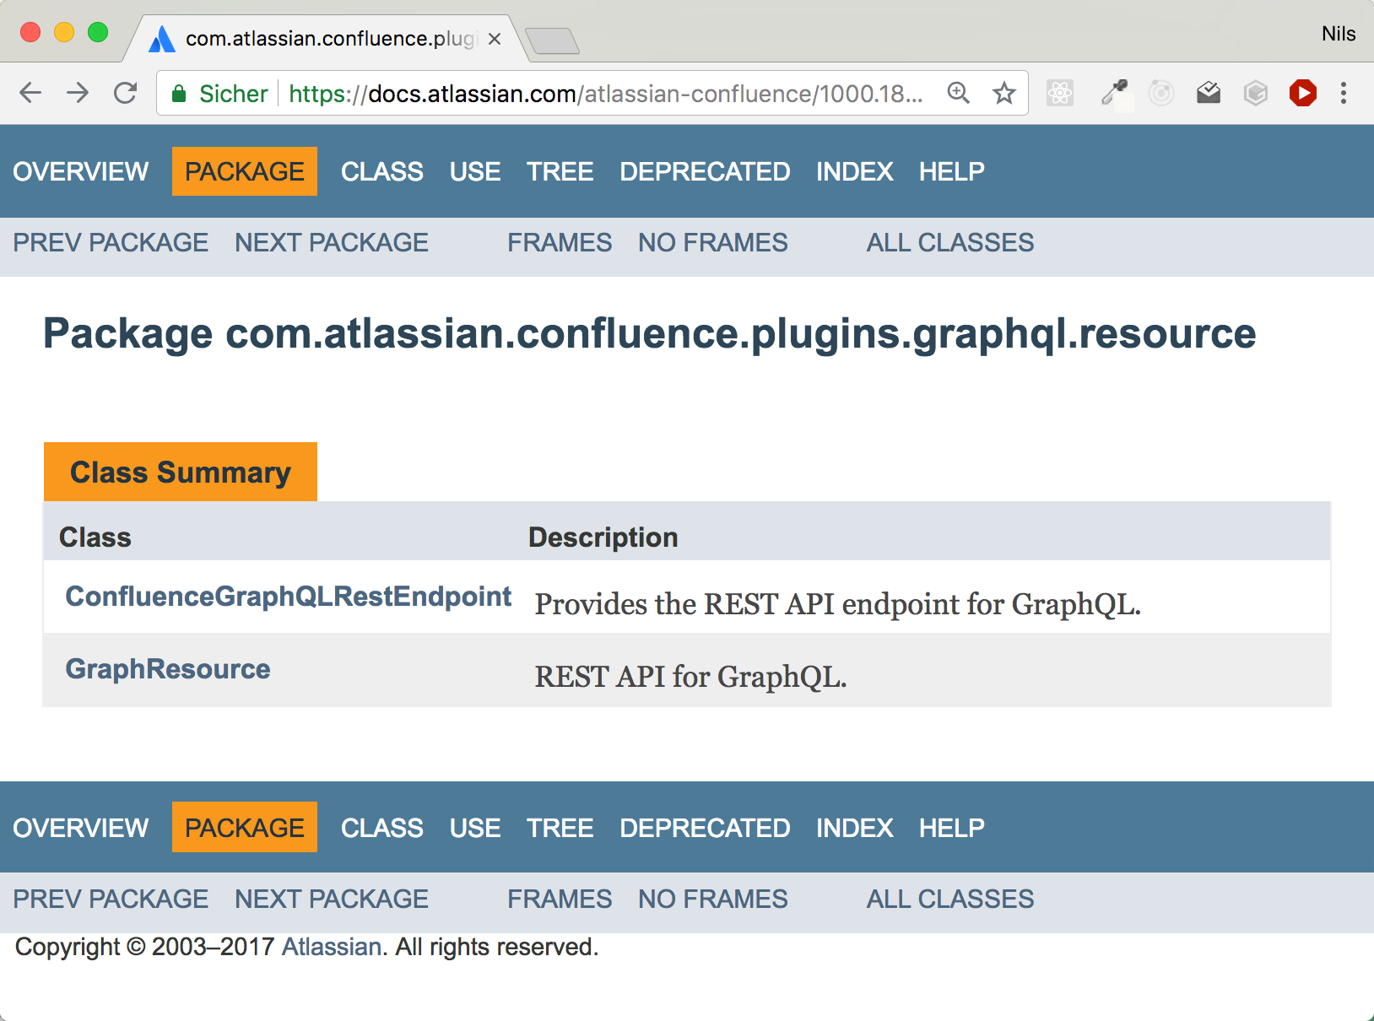
Atlassian
🤔
https://docs.atlassian.com/atlassian-confluence/1000.1829.0/overview-summary.html

Slide 13

Twitter
https://twitter.com/tgvashworth/status/862049341472522240

Slide 14

New York Times
https://open.nytimes.com/react-relay-and-graphql-under-the-hood-of-the-times-website-redesign-22fb62ea9764

Slide 15
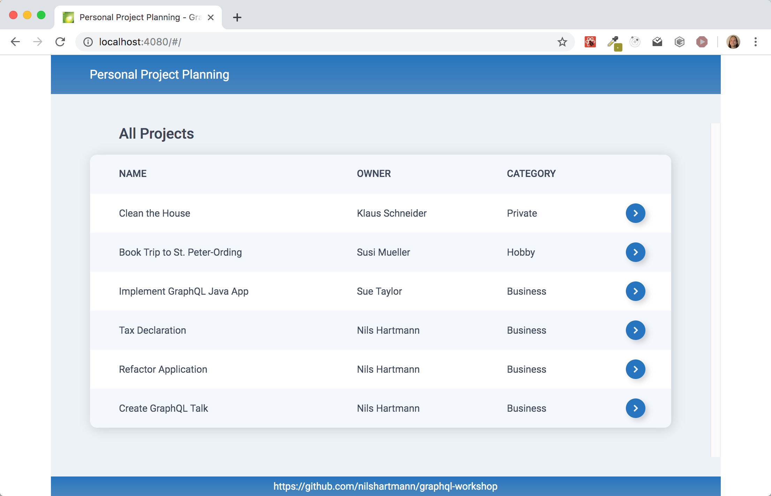
http://localhost:5080
Example Application

Slide 16
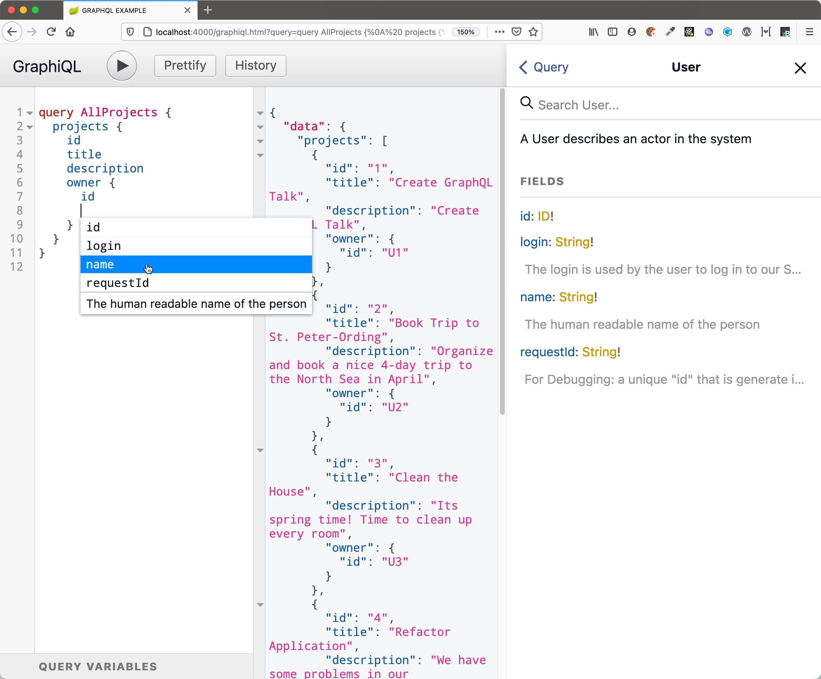
http://localhost:4000
Demo: GraphiQL
https://github.com/graphql/graphiql

Slide 17
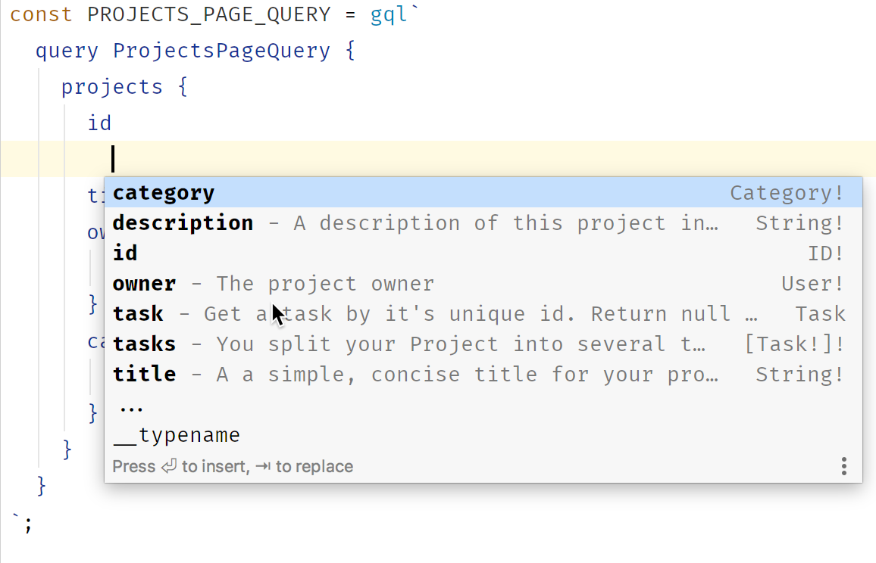
Beispiel: Intellij IDEA
ProjectsPage.tsx
Demo: IDE Support

Slide 18
Teil 1: Abfragen und Schema
"GraphQL is a query language for APIs and a runtime for fulfilling those queries with your existing data"
- https://graphql.org
GraphQL

Slide 19
Project Management App
"Architecture" of our example application
Project Management Application
http://localhost:5000
GraphQL API with graphql-java
Spring Boot
JPA (in-memory DB)
User (Micro-)Service
http://localhost:5010/users/{id}
REST API
Spring Boot

Slide 20
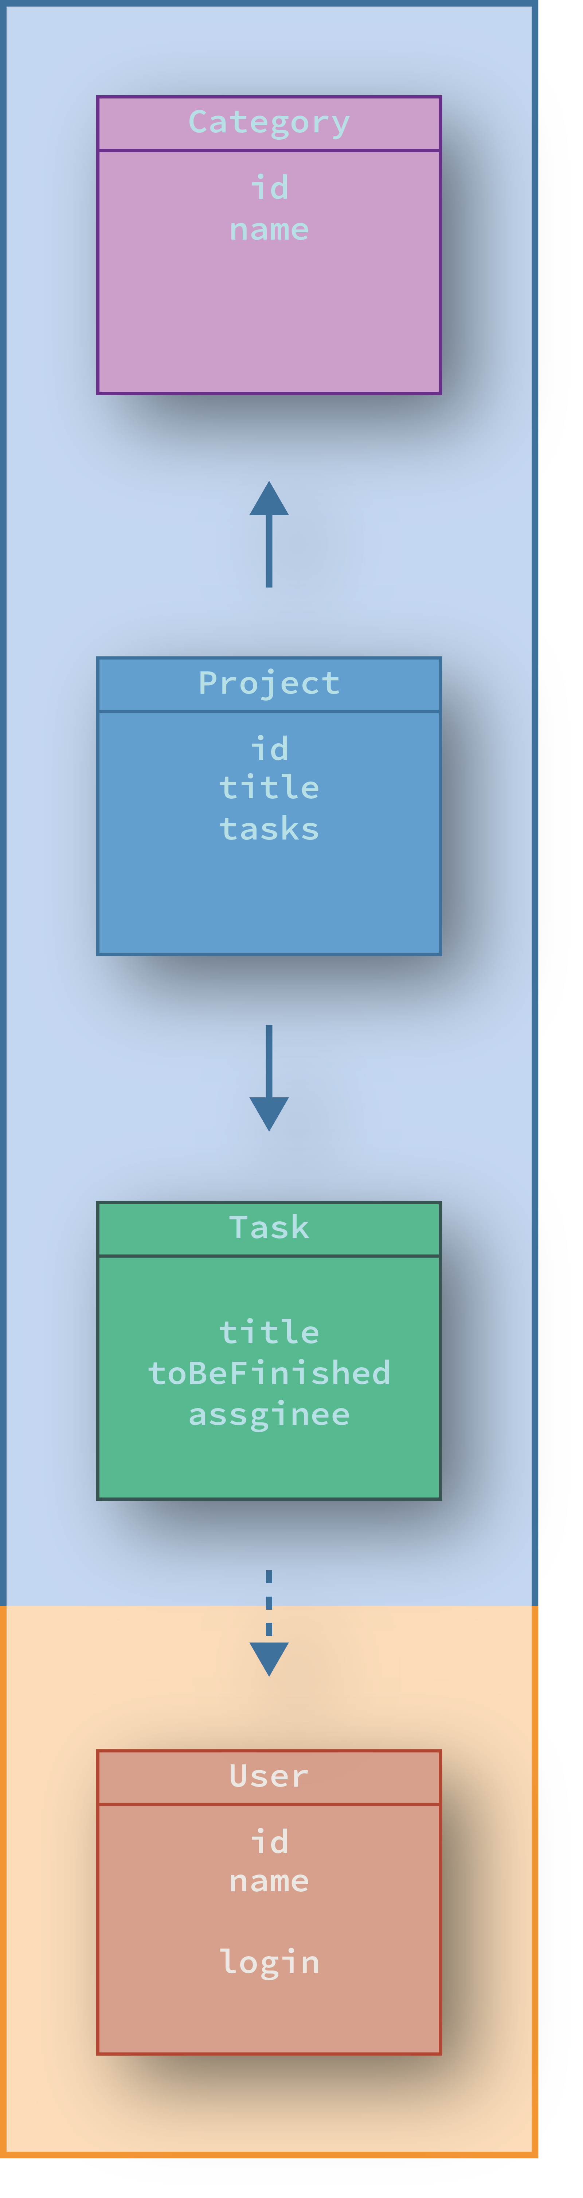
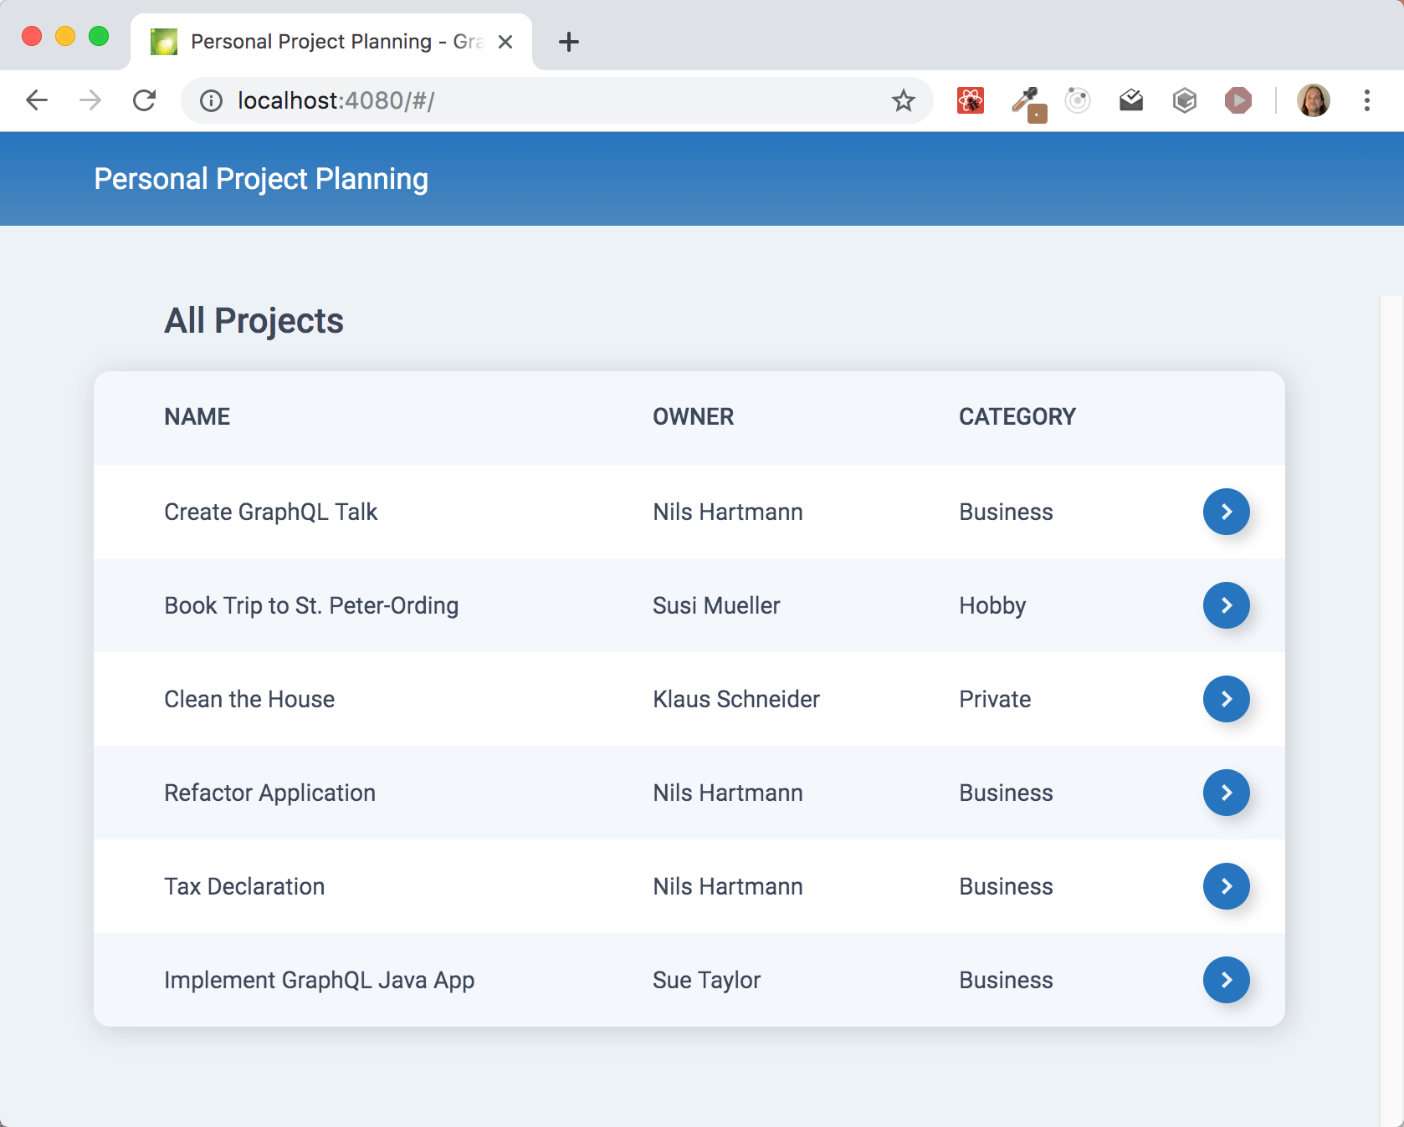
GraphQL
Use-case specific queries
{ projects {
id
title
owner { name }
category { name }
}
}

Slide 21
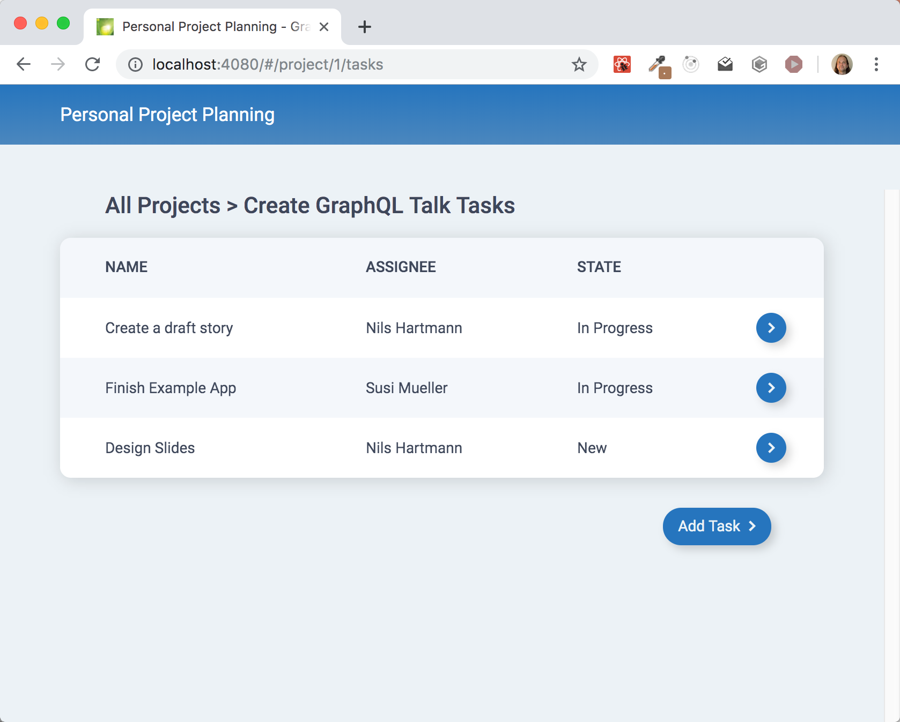
GraphQL Einsatzszenarien
Use-case specific queries 2
{ project(...) {
title
tasks {
name
assignee { name }
state
}
}
}

Slide 22
GraphQL Einsatzszenarien
Use-case specific queries 2
{ project(...) {
title
tasks {
name
assignee { name }
state
}
}
}
Data is queried and requested, not endpoints 😈

Slide 23
Use Cases
Possible reasons for GraphQL
Different use-cases with different data
Multiple views in the frontend
Multiple different clients (public API?)
API can be enhanced independent of the server (more or less)
Client only consumes explizitly queried fields
Overall view of your domain
Type-safe API wanted (for example for code generation)

Slide 24
GraphQL APIs
GraphQL makes no statement about how our API looks like
👉 What data we provide is our decision
👉 We decide how the API of our application looks like GraphQL is "only" technology

Slide 25
GraphQL APIs
GraphQL makes no statement about how our API looks like
👉 What data we provide is our decision
👉 We decide how the API of our application looks like GraphQL is "only" technology
⛔️ "for people who can't make up their minds"

Slide 26
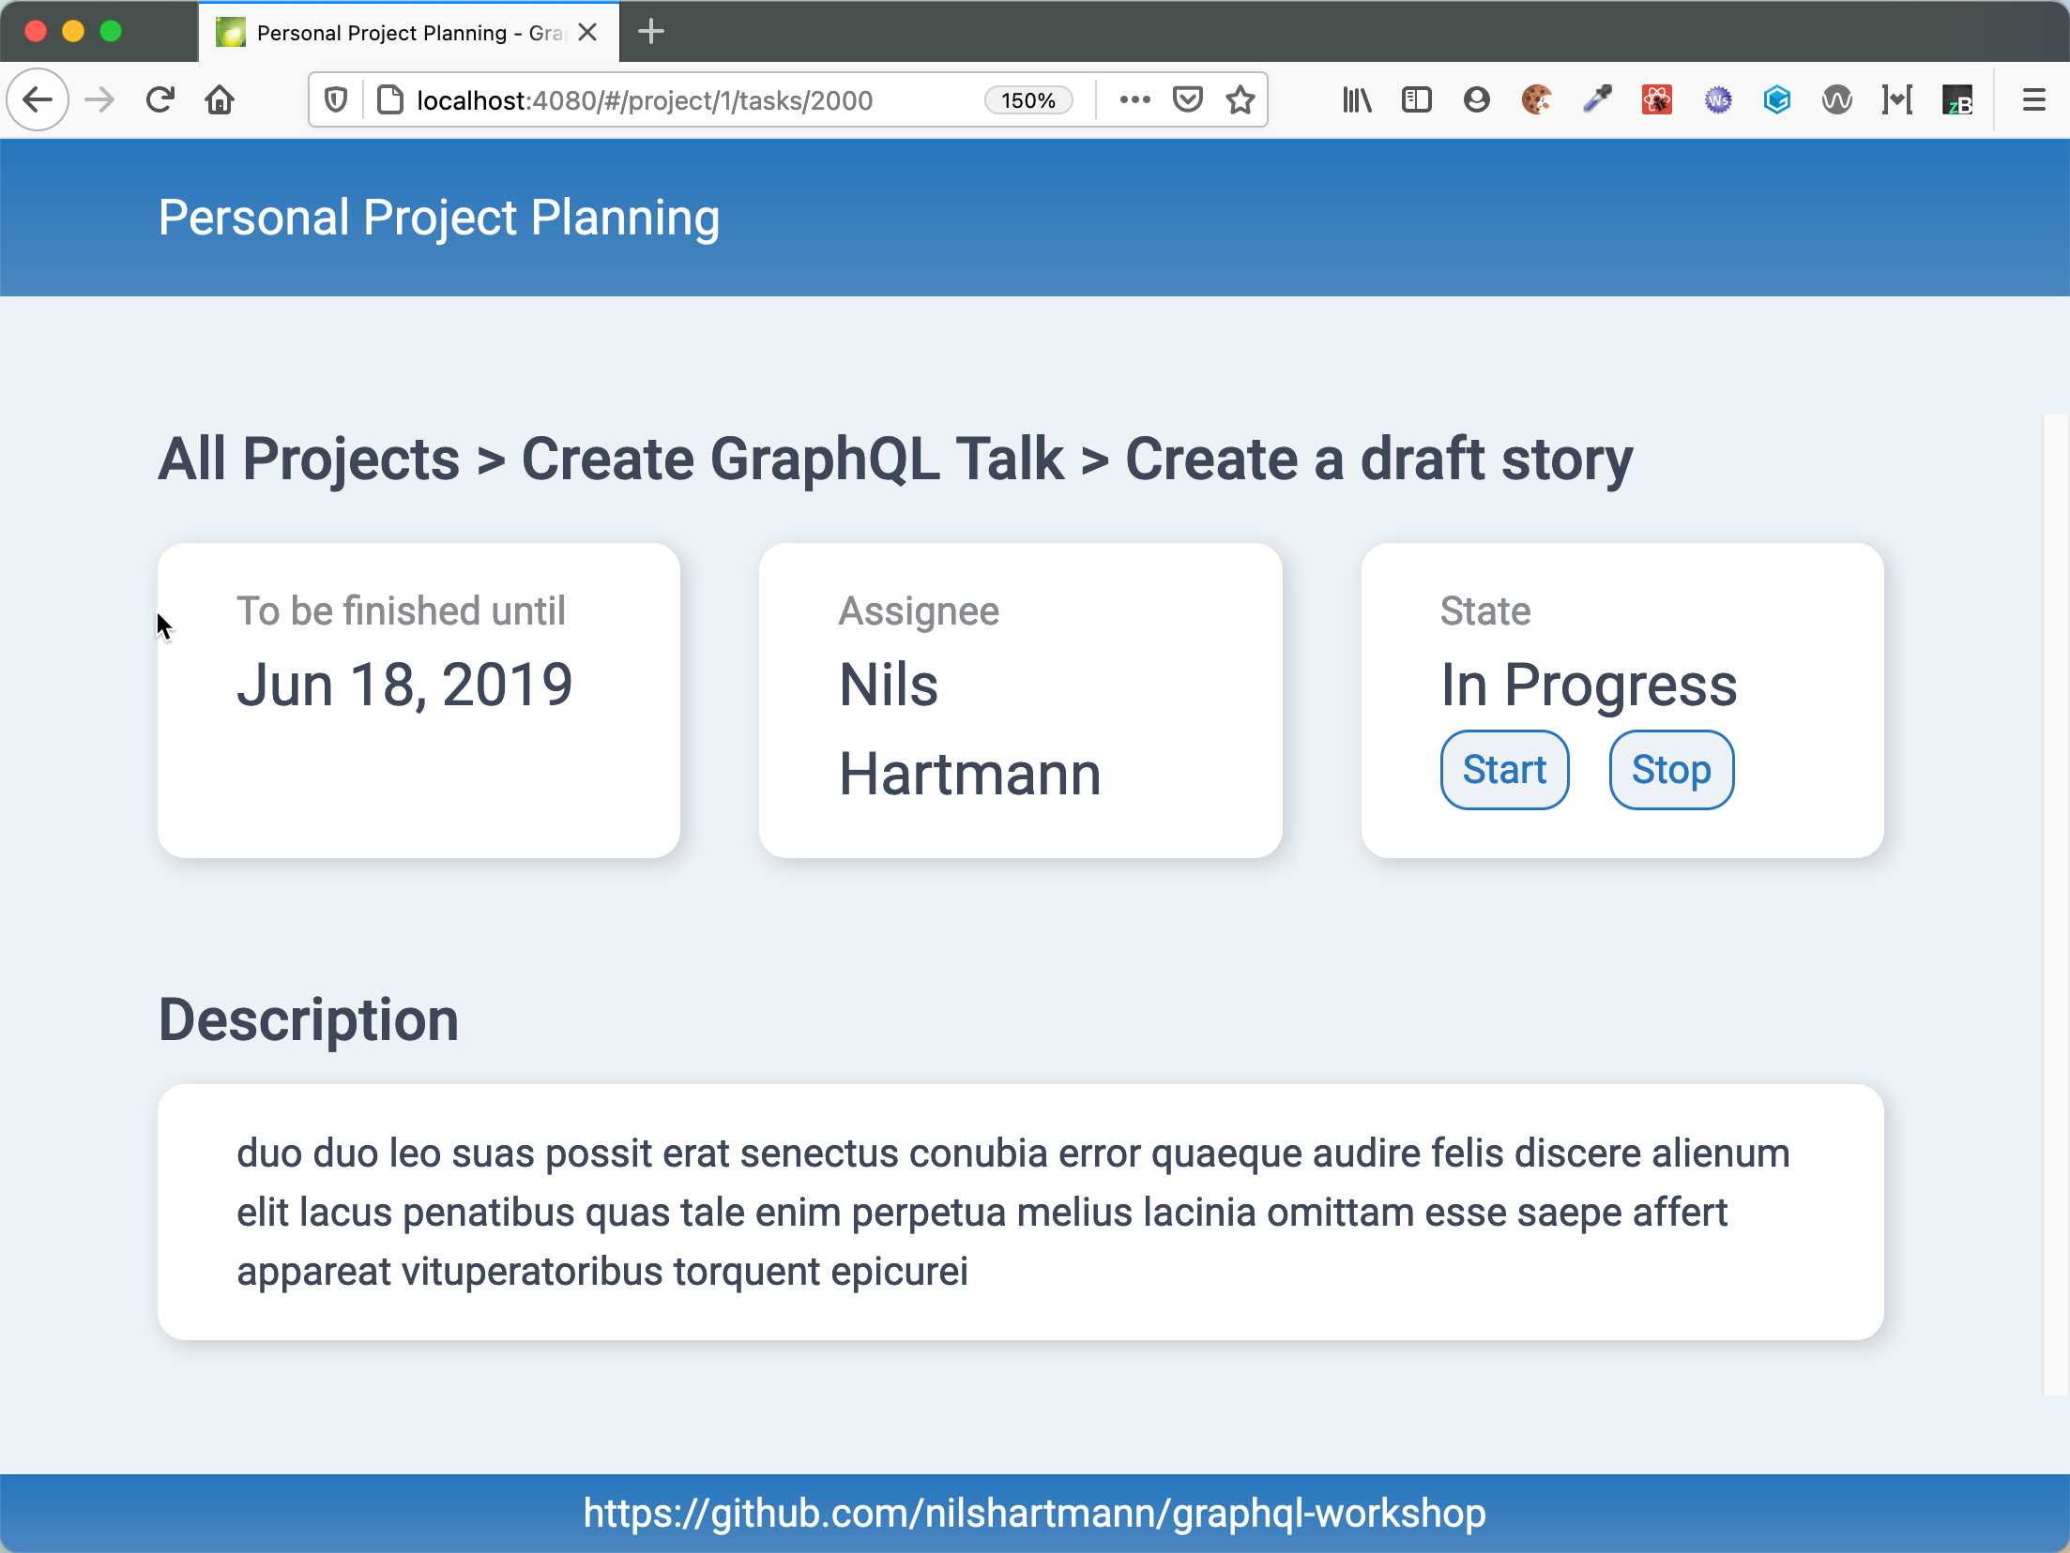
GraphQL Use-case
What about REST/HTTP APIs?
🤔 How would a REST/HTTP API look like?
🤔 What would be the pros/cons?

Slide 27
The GraphQL Query Language

Slide 28
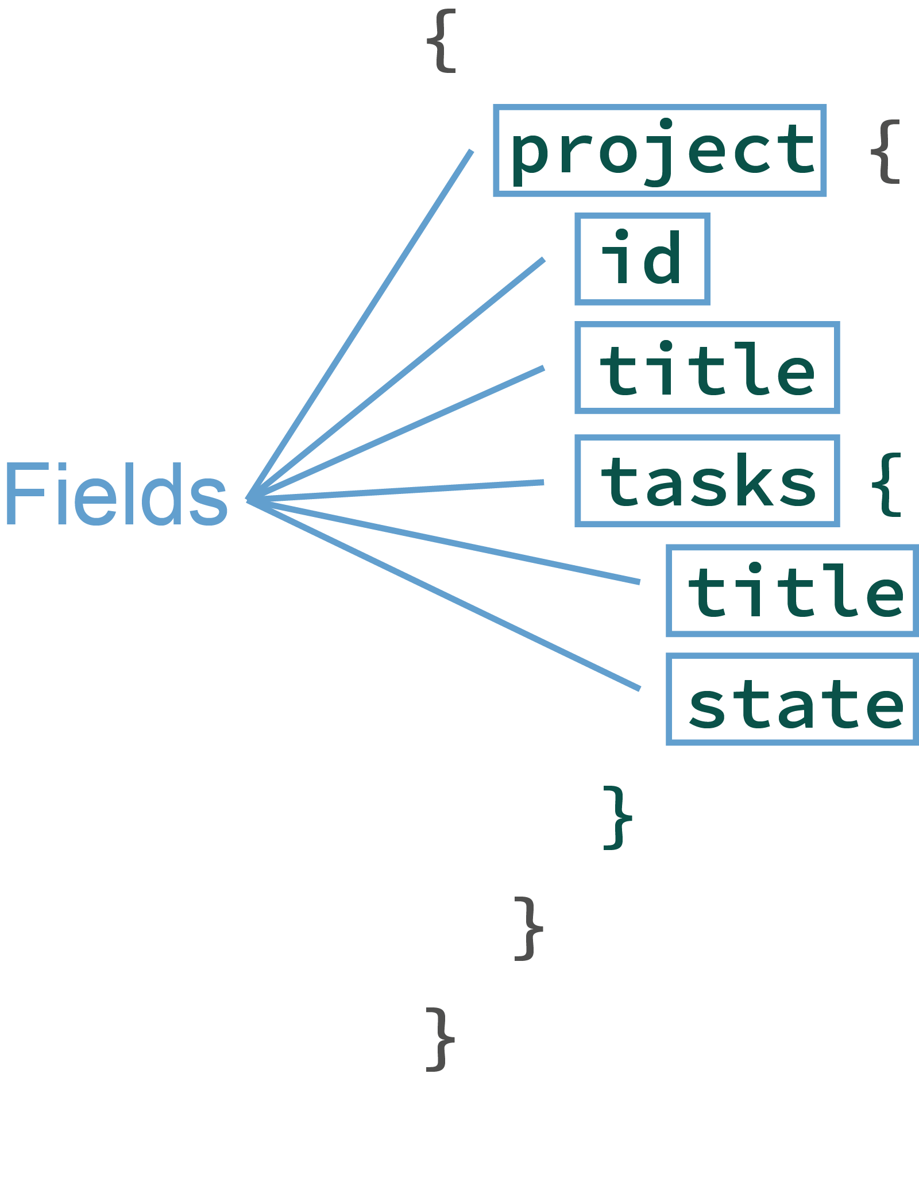
query Language
Structured Language to query/request data from your API
With the language, you select fields from object graphs

Slide 29
query Language
Structured Language to query/request data from your API
With the language, you select fields from object graphs
Fields can have arguments

Slide 30
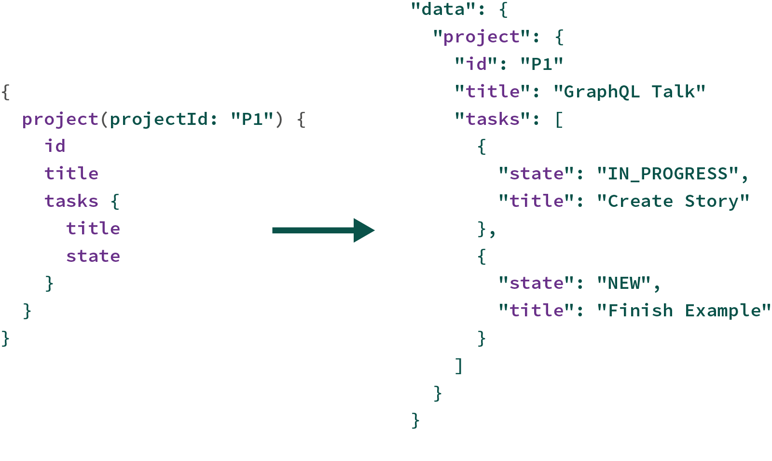
query Language
Query Result
Identical structure as your query

Slide 31
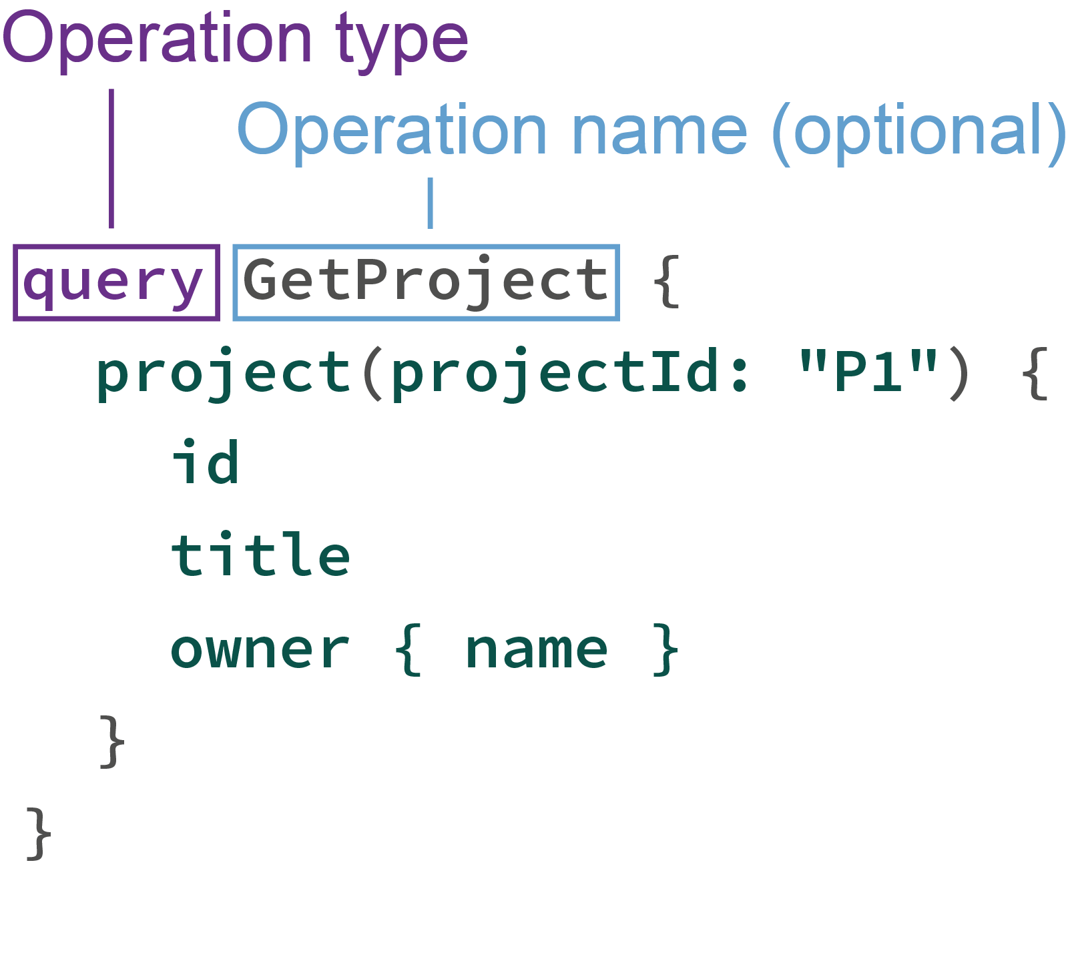
query Language: Operations
Operation: describe, what the query should do
query, mutation, subscription

Slide 32
query Language: Fragments
Fragments
Using fragments you can define reusable subsets of selections
👉 GraphiQL!
fragment UserWithIdAndName on User {
id
name
}

Slide 33
query Language: Fragments
Fragments
Using fragments you can define reusable subsets of selections
fragment UserWithIdAndName on User {
id
name
}
query {
projects {
owner {
...UserWithIdAndName
}
}
}
User!

Slide 34
query Language: Fragments
Fragments
Using fragments you can define reusable subsets of selections
fragment UserWithIdAndName on User {
id
name
}
query {
projects {
owner {
...UserWithIdAndName
}
tasks {
assignee {
...UserWithIdAndName
}
}
}
}
User!
User!

Slide 35
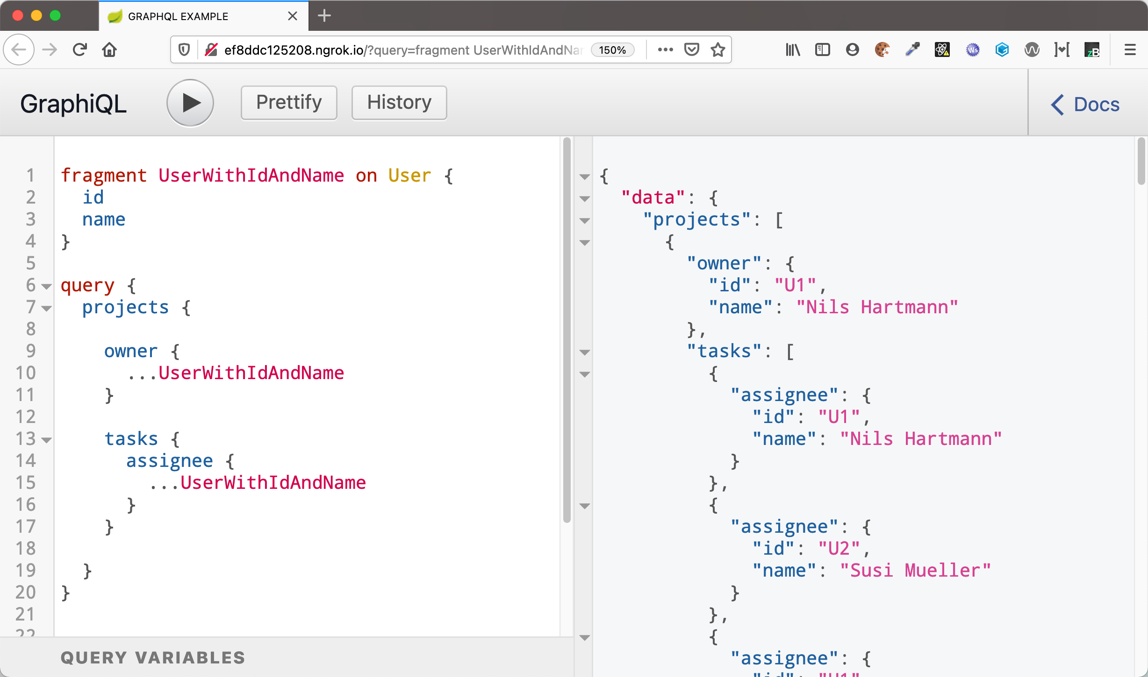
query Language: Fragments
Fragments
Using fragments you can define reusable subsets of selections

Slide 36
query Language: Operations
Operation: Variables
Variables can be used to insert placeholders, as in prepared statements
They're send in a separate object to the server
👉 GraphiQL!

Slide 37
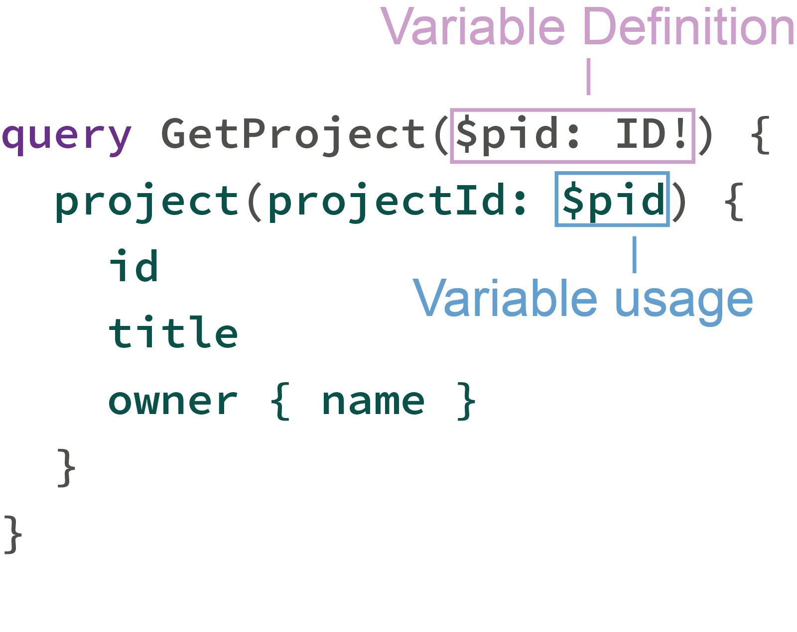
query Language: Operations
Operation: Variables
Variables can be used to insert placeholders, as in prepared statements
They're send in a separate object to the server
👉 GraphiQL!

Slide 38
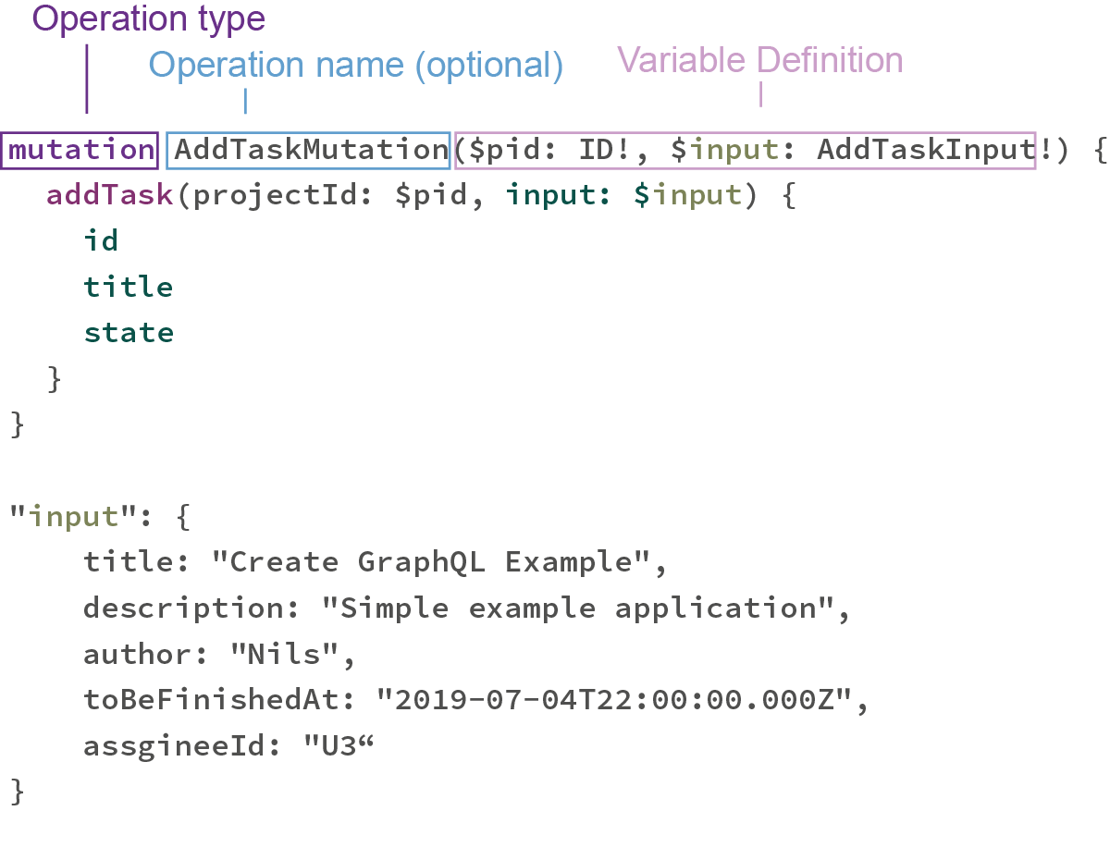
query Language: Mutations
Mutations
Mutations can be used to modifiy data
(would be POST, PUT, PATCH, DELETE in REST)

Slide 39
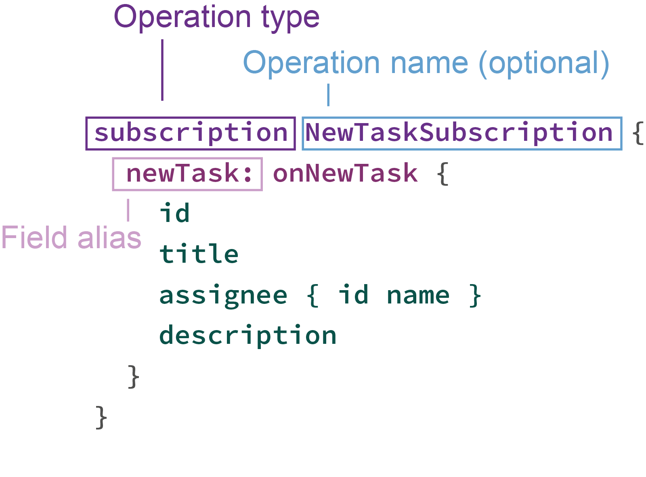
query Language: Mutations
Subscription
Client of your API can subscribe to Server Events, published by the API

Slide 40
Exercise: running Queries
Familiarise yourself with GraphiQL and the query language
Open GraphiQL on my machine, I'll copy the URL to the chat
Explore the API of the project management application
Execute a Query, that reads all projects and their owners (esp. their IDs)
Pick one of the returned projects and execute a Mutation, that adds a new task to the project Can you pass the data for the new task as a Variable to your query?
Please raise your hand in zoom if you're ready. 🙋

Slide 41
Executing Queries
Queries can be executed by HTTP requests
Normaly using HTTP POST (differes enormous from REST...)
Only one endpoint for all queries
$ curl -X POST -H "Content-Type: application/json" \
-d '{"query":"{ projects { title } }"}' \
http://localhost:5000/graphql
{"data":
{"projects": [
{"title": "Create GraphQL Talk"},
{"title ": "Book Trip to St. Peter-Ording"},
{"title ": "Clean the House"},
{"title ": "Refactor Application"},
{"title ": "Tax Declaration"},
{"title ": "Implement GraphQL Java App"}
]}
}

Slide 42
Executing Queries
Response from Server
(JSON-)Map with three defined fields on root-level
data: your requested data, as seen before
{
{"data": {"projects": [ . . . ] },
}

Slide 43
Executing Queries
Response from Server
errors: a list of errors for fields that could not be requested
still HTTP 200 !
{
{"data": {"projects": [ . . . ] },
{"errors":
[
{ "message": "Could not read User with ID 123",
"locations": [ . . . ],
"path": [ "project", "task", "assignee" ]
}
]
},
}

Slide 44
Executing Queries
Response from Server
extensions: proprietary data from your GraphQL framework
Example: logging/debugging informations
{
{"data": {"projects": [ . . . ] },
{"errors":
[
{ "message": "Could not read User with ID 123",
"locations": [ . . . ],
"path": [ "project", "task", "assignee" ]
}
]
},
{"extensions": { . . . }
}

Slide 45
Part II
GraphQL
Server

Slide 46
Runtime (AKA: Your application)
"GraphQL is a query language for APIs and a runtime for fulfilling those queries with your existing data"
- https://graphql.org
GraphQL
Server

Slide 47
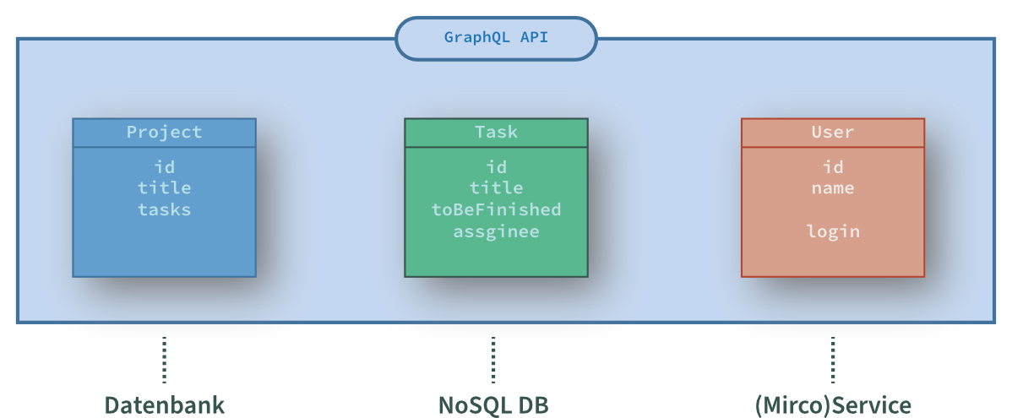
GraphQL Runtime
GraphQL doesn't say anthing about the source of data
👉 Determining the requested data is our task
👉 Data might not only come from (one) database

Slide 48
GraphQL For Java applications
Option 1: graphql-java
https://www.graphql-java.com/
Pure GraphQL implementation, environment independent (no relations to Spring or JEE)
API is quite low level and sometimes feels "uncommon"
As this is the base for some other frameworks, we will use this in the following part of this workshop

Slide 49
GraphQL For Java applications
Option 2: graphql-java-tools
https://github.com/graphql-java-kickstart/graphql-java-tools
Again, only GraphQL, not Spring/JEE requirements
Implement your API using POJOs (might be comparable to Controller classes in Spring/JEE)
Modular approach, several further projects exists, for example GraphQL Servlets or autoconfiguration for Spring Boot
In our Workshop, the example app uses the GraphQL Servlet project (https://www.graphql-java-kickstart.com/servlet/ )

Slide 50
GraphQL For Java applications
Option 3: MicroProfile GraphQL
https://github.com/eclipse/microprofile-graphql
First version pulished in 2020
No support for Subscriptions yet
Schema will be defined by annotations in your java code
Supported by Wildfly, Quarkus und Open Liberty and others

Slide 51
GraphQL For Java applications
Optiona 4: Nextflix Domain Graph Service Framework (DGS)
https://netflix.github.io/dgs/
Published first in February 2021 (!)
Based on Spring Boot and graphql-java
Annotation-based programming model
Code-Generator for Gradle and Maven creates from your schema definition Java classes
Supports Subscriptions
Support for Apollo Federation (Popular?) Gateway to combine multiple GraphQL APIs

Slide 52
GraphQL-java
graphql-java: https://www.graphql-java.com/
"only" GraphQL framework, no server, no DI, ...
no relation to JavaEE or Spring
there are various example and other projects for integrating graphql-java with JavaEE / Spring

Slide 53
GraphQL Server with graphql-java
Our development tasks
Define the Schema of our API (graphql-java)
Implement DataFetchers that collect the requested data (graphql-java)
Expose GraphQL API to an HTTP endpoint (other framework)

Slide 54
GraphQL Schema
Schema
A GraphQL API have to be defined with a Schema
Schema describes Types and Fields of your API
Only Queries (and Responses) that match your schema are executed (and returned)
Schema Definition Language (SDL)

Slide 55
GraphQL Schema
Schema Definition with SDL https://graphql.org/learn/schema/
Object Type
type Project { id: ID!
title: String! description: String
}
Fields

Slide 56
GraphQL Schema
Schema Definition with SDL
type Project { id: ID!
title: String! description: String
}
Return Type (non-nullable)
Return Type (nullable)
Scalar types:
Int
Float
String
Boolean
ID (Serialized to string, but it's value never get's interpreted somehow)

Slide 57
GraphQL Schema
Schema Definition with SDL
type Project { id: ID!
title: String! description: String
owner: User!
}
type User {
id: ID!
name: String!
}
Reference to other type

Slide 58
GraphQL Schema
Schema Definition with SDL
type Project { id: ID!
title: String! description: String
owner: User!
tasks: [Task!]!
}
type User {
id: ID!
name: String!
}
type Task {
id: ID!
}
Return Type
List / Array

Slide 59
GraphQL Schema
Schema Definition with SDL
type Project { id: ID!
title: String! description: String
owner: User!
tasks: [Task!]!
task(taskId: ID!): Task
}
type User {
id: ID!
name: String!
}
type Task {
id: ID!
}
Arguments and their types

Slide 60
GraphQL Schema
Schema Definition with SDL
enum TaskState { NEW
RUNNING FINISHED
}
Enumeration (similiar to Java)

Slide 61
GraphQL Schema
Schema Definition with SDL
enum TaskState { NEW
RUNNING FINISHED
}
input AddTaskInput {
title: String!
description: String!
toBeFinished: String!
assigneeId: ID!
}
Enumeration
Input-Type
(für complex Field arguments)

Slide 62
GraphQL Schema
Root-Types: Entry-Points into the API (Query, Mutation, Subscription)
Root-Type
("Query")
type Query { projects: [Project!]!
project(projectId: ID!): Project }
Root-Fields

Slide 63
GraphQL Schema
Root-Types: Entry-Points into the API (Query, Mutation, Subscription)
Root-Type
("Query")
type Query { projects: [Project!]!
project(projectId: ID!): Project }
type Mutation { addTask(newTask: AddTaskInput): Task! }
Root-Fields
Root-Type
("Mutation")
Input Type

Slide 64
GraphQL Schema
Root-Types: Entry-Points into the API (Query, Mutation, Subscription)
Root-Type
("Query")
type Query { projects: [Project!]!
project(projectId: ID!): Project }
type Mutation { addTask(newTask: AddTaskInput): Task! }
type Subscription {
onNewTask: Task!
onTaskChange(projectId: ID!): Task!
}
Root-Fields
Root-Type
("Mutation")
Input Type
Root-Type
("Subscription")

Slide 65
GraphQL for Java Applications
Define Schema using the Schema Definition Language
Documentation (like Javadoc) can be added with #
Or blockwise using """, that also allows Markdown for formatting
"""
A **Project** consists of **Tasks**
"""
type Project {
# The unique ID of this Project
id: ID!
...
}
type Query {
"""Get a project by its ID or null if not found"""
project(projectId: ID!): Project
}

Slide 66
GraphQL Schema
Schema: Instrospection
Root-Fields "__schema" und "__type" (Example)
👉 GraphiQL
{
"data": {
"__type": {
"name": "Project",
"kind": "OBJECT",
"description": "A **Project** is the central entity in our system.\n\nIt is owned by a **User**\nand have 0..n **Tasks** assigned to it. Projects can be grouped by a **Category**\nto make management easier.",
"fields": [
{
"name": "id",
"description": null,
"type": {
"ofType": {
"name": "ID"
}
}
},
...
}
}
query {
__type(name: "Project") {
name
kind
description
fields {
name description
type { ofType { name } }
}
}
}

Slide 67
Schema Evolution
Only one version! Fields always are queried explicitly
You can add new fields add anytime without harm
type Query { projects: [Project!]!
getProjectById(projectId: ID!): Project
}
New field

Slide 68
Schema Evolution
Only one version! Fields always are queried explicitly
You can add new fields add anytime without harm
You can "deprecate" old fields, that should not be used anylonger
Usage of fields by clients can be tracked and analyzed
type Query { projects: [Project!]!
getProjectById(projectId: ID!): Project
project(projectId: ID!): Project @deprecated }
New field
directive

Slide 69
GraphQL for Java applications
Define Schema using SDL
Create one or more .graphqls-files with your schema definition
type User { id: ID! login: String! name: String! } type Project { id: ID! title: String! description: String! owner: User! category: Category!
tasks: [Task!]!
task(id: ID!): Task } type Category { id: ID! name: String! }
enum TaskState {
NEW RUNNING FINISHED }
type Task { id: ID! title: String!
description: String!
state: TaskState!
assignee: User!
toBeFinishedAt: String! }
type Query { users: [User!]!
projects: [Project!]!
project(id: ID!): Project
}
input AddTaskInput { title: ID! description: ID! toBeFinishedAt: String assigneeId: ID! }
type Mutation { addTask(project: ID!, input: AddTaskInput!):
Task!
updateTaskState(taskId: ID!, newState: TaskState!):
Task! }

Slide 70
GraphQL for Java Applications
Modular schemes
A scheme can be split across several files
Types can be extended in other files
// queries.graphqls
type Query {
ping: String
}
// project.graphqls
type Project { ... }
extend type Query {
project(projectId: ID!): Project
}

Slide 71
Excercise - Preparation
Preparation
Before we start with the excercise, we setup the workspace together step-by-step

Slide 72
Excercise - Preparation
Setup your Workspace
Make sure, you're sources are up-to-date:
If not done already, please clone the workspace:
git clone https://github.com/nilshartmann/graphql-java-workshop
otherwise please pull latest changes: git pull
When you're done, please raise your hand in Zoom 🙋

Slide 73
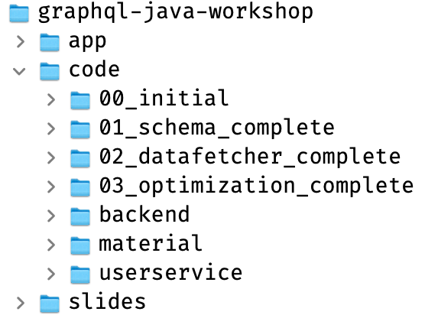
Excercise - Preparation
Preparation
The Workshop Repository
Solutions for excercices
The Project Example Application (write your code here)
User Service

Slide 74
Excercise - Preparation
Preparation
Step 1: Start User Service
Open Bash/Shell/Command Line (no IDE needed!)
Run: ./gradlew bootRun
Test User Service API: http://localhost:5010/users
Raise hand when User Service runs 🙋

Slide 75
Excercise - Preparation
Preparation
Step 2: Open and start Example App
Open in your IDE
Start main class from your IDE: nh.graphql.projectmgmt.ProjectMgmtApplication
Open GraphiQL: http://localhost:5000/graphiql.html
Raise hand when GraphiQL runs 🙋

Slide 76
Excercise: Define API Schema
Plugins for you IDE (not needed for today)
GraphQL Plug-in für IDEA "JS GraphQL"
https://plugins.jetbrains.com/plugin/8097-js-graphql
GraphQL Plug-in für Eclipse 😢
Anyone aware?
GraphQL Extension for VS Code "Apollo GraphQL for VS Code"
https://marketplace.visualstudio.com/items?itemName=apollographql.vscode-apollo

Slide 77
Excercise: Define API Schema
Excercise: Complete the schema for the Example Application
Open src/main/resources/projectmgmt.graphqls
You find TODOs in there with further information
After changing and saving the file you can inspect your changes in GraphiQL: http://localhost:5000/graphiql.html
You can see your changes in the Docs tab on the right side.
Running the queries does not work yet!
When you're finished, please raise your hand 🙋
If you have questions, don't hesitate to ask!
You can find a solution in code/01_schema_complete

Slide 78
Resolving your query: Data Fetchers

Slide 79
Data Fetchers
DataFetcher (in other GraphQL libs sometimes called Resolvers)
A DataFetcher determines and returns the value for a Field
Required for all fields of your Root-Types (Query, Mutation)
For all other fields, Reflection can be used (getter/setter, Maps, ...)

Slide 80
Data Fetchers
DataFetcher (in other GraphQL libs sometimes called Resolvers)
A DataFetcher determines and returns the value for a Field
Required for all fields of your Root-Types (Query, Mutation)
For all other fields, Reflection can be used (getter/setter, Maps, ...)
A DataFetcher is a functional interface in Java (and can be implemented as a Lambda function)

Slide 81
Data Fetchers
DataFetcher (in other GraphQL libs sometimes called Resolvers)
A DataFetcher determines and returns the value for a Field
Required for all fields of your Root-Types (Query, Mutation)
For all other fields, Reflection can be used (getter/setter, Maps, ...)
A DataFetcher is a functional interface in Java (and can be implemented as a Lambda function)
interface DataFetcher<T> { T get(DataFetchingEnvironment environment); }

Slide 82
Data Fetchers
DataFetcher (in other GraphQL libs sometimes called Resolvers)
A DataFetcher determines and returns the value for a Field
Required for all fields of your Root-Types (Query, Mutation)
For all other fields, Reflection can be used (getter/setter, Maps, ...)
A DataFetcher is a functional interface in Java (and can be implemented as a Lambda function)
Later we will see, how we connect a DataFetcher to our schema
interface DataFetcher<T> { T get(DataFetchingEnvironment environment); }

Slide 83
DataFetcher
Implementing DataFetchers
Example: A simple ping-Field 👉 PingFetcher
Schema Definition
type Query { ping: String!
}

Slide 84
DataFetcher
Implementing DataFetchers
Example: A simple ping-Field 👉 Try in GraphiQL
Schema Definition
type Query { ping: String!
}
"data": {
"ping": "Hello, World"
}
Query
query { ping }

Slide 85
DataFetcher
Implementing DataFetchers
Example: A simple ping-Field
Schema Definition
type Query { ping: String!
}
"data": {
"ping": "Hello, World"
}
Query
query { ping }
Data Fetcher
public class QueryDataFetchers {
DataFetcher<String> ping = new DataFetcher<>() {
public String get(DataFetchingEnvironment env) {
return "Hello, World";
}
};
// or: as Lambda-Function
DataFetcher<String> ping = env -> "Hello World";
}

Slide 86
DataFetcher
The DataFetcherEnvironment
DataFetcher receiving instances of DataFetcherEnvironment
This class provides information about the query and it's environment
It provides the arguments for a field
We will see more use-cases later
interface DataFetcherEnvironment { <T> T getArgument(String name);
<T> T getSource();
<T> T getContext();
DataFetchingFieldSelectionSet getSelectionSet();
<K, V> DataLoader<K, V> getDataLoader(String dataLoaderName);
}

Slide 87
DataFetcher
Implementing DataFetchers: Arguments
👉PingField

Slide 88
DataFetcher
Implementing DataFetchers: Arguments
The DataFetchingEnvironment provides the given arguments of a field
(Complex) input-Types are passed as Map-Instances (more on that later)
Schema Definition
type Query { ping(msg: String): String!
}
query {
ping(msg: "GraphQL")
}
"data": {
"ping": "Hello, GraphQL"
}
Query

Slide 89
DataFetcher
Implementing DataFetchers: Arguments
The DataFetchingEnvironment provides the given arguments of a field
(Complex) input-Types are passed as Map-Instances (more on that later)
Schema Definition
type Query { ping(msg: String): String!
}
query {
ping(msg: "GraphQL")
}
"data": {
"ping": "Hello, GraphQL"
}
Query
Data Fetcher
public class QueryDataFetchers {
DataFetcher<String> ping = new DataFetcher<>() {
public String get(DataFetchingEnvironment env) {
String msg = env.getArgument("msg");
if (msg == null) { msg = "World"; }
return "Hello, " + msg;
}
};
}

Slide 90
DataFetcher
DataFetcher: Mutations
technically the same as queries, but you're allowed to modify data here
Schema Definition
input AddTaskInput { title: String!
description: String!
}
type Mutation { addTask(projectId: ID!, input: AddTaskInput!): Task!
}
Data Fetcher
public class MutationDataFetchers {
DataFetcher<Task> addTask = new DataFetcher<>() {
public Task get(DataFetchingEnvironment env) {
String projectId = env.getArgument("projectId");
Map input = env.getArgument("input");
String title = input.get("title");
String description = input.get("description");
return taskService.newTask(projectId, title, description);
}
};
}

Slide 91
DataFetcher
DataFetcher: Subscriptions
Same as DataFetchers for Query, but must return Reactive Streams Publisher
Typically used in Web-Clients with WebSockets
Overall setup and configuration can be tricky
import org.reactivestreams.Publisher;
public DataFetcher<Publisher<Task>> onNewTask() {
return environment -> {
Publisher<Task> publisher = getTaskPublisher();
return publisher;
};
}
// Publisher: nh.graphql.tasks.domain.TaskPublisher
type Subscription {
onNewTask: Task!
}

Slide 92
DataFetcher
Implementing DataFetchers: Context
Context can be used to pass informations to data fetchers
You can define the context object yourself
Example: Services or Security Informations (current user, roles, ...)

Slide 93
DataFetcher
Implementing DataFetchers: Context
Context can be used to pass informations to data fetchers
You can define the context object yourself
Example: Services or Security Informations (current user, roles, ...)
Data Fetcher
public class QueryDataFetchers {
DataFetcher<String> ping = new DataFetcher<>() {
public Project get(DataFetchingEnvironment env) {
ProjectMgmtGraphQLContext context = env.getContext();
ProjectRepository repo = context.getProjectRepository();
Project project = projectRepository.find(...);
...
}
};
}

Slide 94
DataFetcher
Implementing DataFetcher: Return Values
You can return primitive values, Objects, Lists or Optionals
Schema Definition
type Query { project(id: ID!): Project
}
Project POJO
public class Project {
long id;
String title;
...
}
Data Fetcher
public class QueryDataFetchers {
DataFetcher<Optional<Project>> projectById = new DataFetcher<>() {
public String get(DataFetchingEnvironment env) {
String projectId = env.getArgument("id");
ProjectRepository repository = ...;
Optional<Project> project = repository.get(projectId);
return project;
}
};
}

Slide 95
Runtime Wiring
Connecting Fields to DataFetchers
The RuntimeWiring connects your DataFetcher with Fields
class GraphQLAPIConfiguration {
RuntimeWiring setupWiring() {
QueryFetchers queryFetchers = ...;
MutationFetchers mutationFetchers = ...;
ProjectFetchers projectFetchers = ...;
return RuntimeWiring.newRuntimeWiring()
.build();
}
}

Slide 96
Runtime Wiring
Connecting Fields to DataFetchers
The RuntimeWiring connects your DataFetcher with Fields
class GraphQLAPIConfiguration {
RuntimeWiring setupWiring() {
QueryFetchers queryFetchers = ...;
MutationFetchers mutationFetchers = ...;
ProjectFetchers projectFetchers = ...;
return RuntimeWiring.newRuntimeWiring()
.type(newTypeWiring("Query")
.build();
}
}
type Query {
}

Slide 97
Runtime Wiring
Connecting Fields to DataFetchers
The RuntimeWiring connects your DataFetcher with Fields
class GraphQLAPIConfiguration {
RuntimeWiring setupWiring() {
QueryFetchers queryFetchers = ...;
MutationFetchers mutationFetchers = ...;
ProjectFetchers projectFetchers = ...;
return RuntimeWiring.newRuntimeWiring()
.type(newTypeWiring("Query")
.dataFetcher("ping", queryFetchers.ping)
.dataFetcher("project", queryFetchers.projectById))
.build();
}
}
type Query { ping: String!
project(id: ID!): Project
}

Slide 98
Runtime Wiring
Connecting Fields to DataFetchers
The RuntimeWiring connects your DataFetcher with Fields
class GraphQLAPIConfiguration {
RuntimeWiring setupWiring() {
QueryFetchers queryFetchers = ...;
MutationFetchers mutationFetchers = ...;
ProjectFetchers projectFetchers = ...;
return RuntimeWiring.newRuntimeWiring()
.type(newTypeWiring("Query")
.dataFetcher("ping", queryFetchers.ping)
.dataFetcher("project", queryFetchers.projectById))
.type(newTypeWiring("Project").
.dataFetcher("owner", projectFetchers.owner))
.build();
}
}
type Query { ping: String!
project(id: ID!): Project
}
type Project { owner: User!
}

Slide 99
Runtime Wiring
Connecting Fields to DataFetchers
The RuntimeWiring connects your DataFetcher with Fields
class GraphQLAPIConfiguration {
RuntimeWiring setupWiring() {
QueryFetchers queryFetchers = ...;
MutationFetchers mutationFetchers = ...;
ProjectFetchers projectFetchers = ...;
return RuntimeWiring.newRuntimeWiring()
.type(newTypeWiring("Query")
.dataFetcher("ping", queryFetchers.ping)
.dataFetcher("project", queryFetchers.projectById))
.type(newTypeWiring("Project").
.dataFetcher("owner", projectFetchers.owner))
.type(newTypeWiring("Mutation").
.dataFetcher("addTask", mutationFetchers.addTask))
.build();
}
}
type Query { ping: String!
project(id: ID!): Project
}
type Project { owner: User!
}
type Mutation { addTask(projectId:...): Task
}

Slide 100
GraphQL for Java applications

Slide 101
Excercise: Implement a DataFetcher
In case, you look at the example application, some notes...
Schema is created in GraphQLApiConfiguration.java
Code there is slightly different to what we've seen on slides, as it uses some Spring code
Our GraphQL API is exposed as HTTP endpoint using the graphql-java-servlet that is manually registered using Spring API

Slide 102
Excercise: Implement a DataFetcher
Implement missing Query-DataFetchers for our Application
For the Query-type, DataFetchers for fields projects and project are missing 😢
Please implement them in nh.graphql.projectmgmt.graphql.fetcher.QueryDataFetchers
Add them to RuntimeWiring in GraphQLApiConfiguration.setupWiring()
In both files you, find TODOs
If you haven't finished excercise 1, you can find a complete, working schema file in 01_schema_complete/ src/main/resources, that your can copy into your workspace
After implementing your changes, you can now execute queries in GraphiQL
Find some example queries on the next page
owner and assignee and single task fields cannot be queried yet!
When you're finished, please raise hand in Zoom 🙋

Slide 103
Excercise: Implement a DataFetcher
Implement missing Query-DataFetchers for our Application
After implementing your DataFetcher, the following queries should work:
Note: query for owner / assignee or a single project task will NOT work yet.
query {
projects {
id title
tasks {
id title
}
}
}
query {
project(id: "1") {
id title
tasks {
id title
}
}

Slide 104
More on Graphql-Java

Slide 105
Object GraphS
Implementing DataFetcher: Objekt Graphs
In nested Queries the return value of a DataFetcher is passed as "source" to the next DataFetcher
QueryDataFetchers.projectById:
returns an instance of our Project class
public class Project {
long id;
String title;
Category category;
...
}
query {
project(id: 1) {
id
title
category
{ name }
}
}

Slide 106
Object GraphS
Implementing DataFetcher: Objekt Graphs
In nested Queries the return value of a DataFetcher is passed as "source" to the next DataFetcher
If there is no DataFetcher configured for a field, a PropertyDataFetcher is used by default
The PropertyDataFetcher tries to receive values using Reflection
For Root-Fields an own DataFetcher is required!
QueryDataFetchers.projectById:
returns an instance of our Project class
public class Project {
long id;
String title;
Category category;
...
}
query {
project(id: 1) {
id
title
category
{ name }
}
}
PropertyDataFetcher
receives the Project instance from QueryDataFetcher
tries to get values (id, title, category) by Reflection

Slide 107
Object GraphS
Implementing DataFetcher: Objekt Graphs
In nested Queries the return value of a DataFetcher is passed as "source" to the next DataFetcher
If there is no DataFetcher configured for a field, a PropertyDataFetcher is used by default
The PropertyDataFetcher tries to receive values using Reflection
For Root-Fields an own DataFetcher is required!
QueryDataFetchers.projectById:
returns an instance of our Project class
public class Project {
long id;
String title;
Category category;
...
}
query {
project(id: 1) {
id
title
category
{ name }
}
}
PropertyDataFetcher
receives the Project instance from QueryDataFetcher
tries to get values (id, title, category) by Reflection
PropertyDataFetcher
receives Category-Instance from ProjectDataFetcher
and so on

Slide 108
Object GraphS
DataFetcher for own Types (not Root Types)
Default PropertyDataFetcher does not always work
If there is a "mismatch" between your GraphQL API and Java API
Different/missing field names
other types

Slide 109
Object GraphS
DataFetcher for own Types (not Root Types)
Default PropertyDataFetcher does not always work
If there is a "mismatch" between your GraphQL API and Java API
Different/missing field names
other types
Example: There is no field "owner" on our Project class
only the Id of a User object
(the actual user must be read from MicroService)
public class Project {
long id;
String title;
Category category;
String ownerId;
...
}
query {
project(id: 1) {
id
title
category
{ name }
owner {
name
}
}
}
PropertyDataFetcher does not work here 😱

Slide 110
Object GraphS
DataFetcher for own Types (not Root Types)
You can write DataFetcher for all fields in your GraphQL API
Non-Root Fetcher works the same, as DataFetchers for Root-Fields
They receive their parent object as "Source"-Property from the DataFetchingEnvironment
query {
project(id: 1) {
id
title
category
{ name }
owner {
name
}
}
}
public class ProjectDataFetchers {
DataFetcher<User> owner = new DataFetcher<>() {
public String get(DataFetchingEnvironment env) {
Project parent = env.getSource();
String ownerId = parent.getOwnerId();
UserService userService =
env.getContext().getUserService();
return userService.getUser(ownerId);
}
};
}

Slide 111
Object GraphS
DataFetcher for own Types (not Root Types)
You have to connect your DataFetchers with their types in RuntimeWiring
class GraphQLAPIConfiguration {
RuntimeWiring setupWiring() {
QueryFetchers queryFetchers = ...;
MutationFetchers mutationFetchers = ...;
ProjectFetchers projectFetchers = ...;
return RuntimeWiring.newRuntimeWiring()
.type(newTypeWiring("Query")
// ....
.type(newTypeWiring("Project").
.dataFetcher("owner", projectFetchers.owner))
.build();
}
}
type Project { owner: User!
}

Slide 112
Excercise 3: Implement DataFetcher
Implement DataFetcher for owner and task of the Project type
You need to implement DataFetchers nh.graphql.projectmgmt.graphql.fetcher.ProjectDataFetchers
There you find TODOs
Register your DataFetchers in GraphQLApiConfiguration.setupWiring()!
If you haven't finished the previous excercise, you can copy the class QueryDataFetchers from the folder "02_query_datafetcher_complete" into your workspace and also "GraphQLApiConfiguration" from that folder
Make sure your DataFetchers work, by executing both queries on the following slide
When you're finished, raise your hand 🙋

Slide 113
Excercise 3: Implement DataFetcher
Implement DataFetcher for owner and task of the Project type
Now both queries should work:
query {
projects {
id title
tasks {
id title
}
owner { id name }
}
}
query {
project(id: "1") {
id title
task(id: "2002") {
id title
}
}
}

Slide 114
Background: Running Queries

Slide 115
Background: Running Queries
Executable Schema
Schema und DataFetcher (Wirings) must be connected in a GraphQLSchema
GraphQL Schema is used to execute Queries
class GraphQLApiConfiguration {
public GraphQLSchema graphqlSchema() {
File schemaFile = new File("tasks.graphqls");
RuntimeWiring runtimeWiring = setupWiring();
SchemaGenerator schemaGenerator = new SchemaGenerator();
return schemaGenerator.makeExecutableSchema(
new SchemaParser().parse(schemaFile),
runtimeWiring
);
}
}

Slide 116
Background: Running Queries
Execute Queries in Java
Result will be returned in nested Map
👉 nh.graphql.projectmgmt.graphql.config.GraphQLApiConfiguration 👉 nh.graphql.projectmgmt.QueryExecutionTest
GraphQLSchema schema = ...;
GraphQL graphQL = GraphQL.newGraphQL(schema).build();
ExecutionInput executionInput =
ExecutionInput.newExecutionInput
.query("query { project { title tasks { title } } }")
.context(new ProjectMgmtGraphQLContext())
.build();
Map<String, Object> result = graphQL.execute(executionInput).toSpecification();

Slide 117
Background: exposing your API
Execute Queries using HTTP endpoint
Requirement: GraphQL Schema is created (as seen before)
Option 1: https://github.com/graphql-java/graphql-java-spring
REST Controller for Spring (Boot)
From same team as graphql-java
No support für Subscriptions(?)
Option 2: https://github.com/graphql-java-kickstart/graphql-java-servlet
HTTP Servlet (for Spring or other Servlet Containers)
Spring Boot starter available
Support for Subscriptions

Slide 118
Background: exposing your API
Example: graphql-java-servlet
Deplyoment of servlet is container/server specific
Example from our Spring-based application, just to get an idea:
import javax.servlet.annotation.WebServlet;
import graphql.schema.GraphQLSchema;
import graphql.servlet.GraphQLHttpServlet;
import graphql.servlet.config.GraphQLConfiguration;
@WebServlet(urlPatterns = { "/graphql" }, loadOnStartup = 1)
public class GraphQLServlet extends GraphQLHttpServlet {
@Autowired
private GraphQLSchema schema;
protected GraphQLConfiguration getConfiguration() {
return GraphQLConfiguration
.with(schema)
.build();
}
}

Slide 119
Runtime optimizations

Slide 120
Runtime
An Example...
DataFetcher
DataFetcher<List<Project>> projectsFetcher =
env -> projectRepository.getAll();
DataFetcher<User> ownerFetcher =
env -> userService.getUser(
((Project)env.getSource()).getOwnerId()
);

Slide 121
Runtime
An Example...
DataFetcher
DataFetcher<List<Project>> projectsFetcher =
env -> projectRepository.getAll();
DataFetcher<User> ownerFetcher =
env -> userService.getUser(
((Project)env.getSource()).getOwnerId()
);
Query
query {
projects {
owner {
id name
}
}
}
Question:What happens at runtime? 🤔

Slide 122
Runtime
An Example...
DataFetcher<List<Project>> projectsFetcher =
env -> projectRepository.getAll();
DataFetcher<User> ownerFetcher =
env -> userService.getUser(
((Project)env.getSource()).getOwnerId()
);
One Database call
(returns n Project-objects)
n REST-Calls
(1 for each Project)
query {
projects {
owner {
id name
}
}
}
1+n-Problem 😱

Slide 123
Runtime
Option 1: Async Data Fetcher
DataFetcher can be run asynchronous in parallel
query {
projects {
id
title
tasks {
id title
}
owner { id name }
}
}
For example: could run in parallel

Slide 124
Runtime
Option 1: Async Data Fetcher
DataFetcher can be run asynchronous in parallel
query {
projects {
id
title
tasks {
id title
}
owner { id name }
}
}
Determining all n Tasks could run in parallel, too

Slide 125
Runtime
Option 1: Async Data Fetcher
DataFetcher can be run asynchronous in parallel
query {
projects {
id
title
tasks {
id title
}
owner { id name }
}
}
👉 Example: estimation-Field (ProjectDataFetcher)
👉 Add estimation in GraphQLApiConfiguration

Slide 126
Runtime
Option 1: Async Data Fetcher
DataFetcher can be run asynchronous in parallel
A DataFetcher can therefore return a CompleteableFuture
async convience function can help wrapping a result in a CF
query {
projects {
id
title
tasks {
id title
}
owner { id name }
}
}
Long-running operation
DataFetcher<User> ownerFetcher =
async(env -> userService.getUser(
((Project)env.getSource()).getOwnerId()
));

Slide 127
Laufzeitverhalten
Option 1: Async Data Fetcher
DataFetcher<List<Project>> projectsFetcher =
env -> projectRepository.getAll();
import graphql.schema.AsyncDataFetcher.async;
DataFetcher<User> ownerFetcher =
async(env -> userService.getUser(
((Project)env.getSource()).getOwnerId()
));
One Database call
(returns n Project-objects)
n REST-Calls
(1 for each Project),
but in parallel!
Das not really solve 1+n-problem, but can lead to better performance (also in other use-cases)

Slide 128
Laufzeitverhalten
Back to our example...
DataFetcher
DataFetcher<List<Project>> projectsFetcher = ...;
DataFetcher<User> ownerFetcher = async(...);
Query
query {
projects {
owner {
id name
}
}
}
Result
"data": {
"projects": [
{ "owner": { "id": "U1", "name": "Nils Hartmann" } },
{ "owner": { "id": "U2", "name": "Susi Mueller" } },
{ "owner": { "id": "U3", "name": "Klaus Schneider" }
{ "owner": { "id": "U1", "name": "Nils Hartmann" } },
{ "owner": { "id": "U4", "name": "Sue Taylor" } },
{ "owner": { "id": "U1", "name": "Nils Hartmann" } }
]
}
What is still problematic? 🤔

Slide 129
Runtime
Back to our example...
DataFetcher
DataFetcher<List<Project>> projectsFetcher = ...;
DataFetcher<User> ownerFetcher = async(...);
Query
query {
projects {
owner {
id name
}
}
}
Ergebnis
"data": {
"projects": [
{ "owner": { "id": "U1", "name": "Nils Hartmann" } },
{ "owner": { "id": "U2", "name": "Susi Mueller" } },
{ "owner": { "id": "U3", "name": "Klaus Schneider" }
{ "owner": { "id": "U1", "name": "Nils Hartmann" } },
{ "owner": { "id": "U4", "name": "Sue Taylor" } },
{ "owner": { "id": "U1", "name": "Nils Hartmann" } }
]
}
n+1-problem plus unnecessary redundant loading of data (👉Console) 😱😱

Slide 130
Runtime
Enhanced Query... ...it gets even more evil
DataFetcher
DataFetcher<List<Project>> projectsFetcher = ...;
DataFetcher<User> ownerFetcher = async(...);
DataFetcher<User> assigneeFetcher = ...;
Query
query {
projects {
owner {
id name
}
tasks { assignee { id name }
}
}

Slide 131
Laufzeitverhalten
Enhanced Query... ...it gets even more evil
DataFetcher
DataFetcher<List<Project>> projectsFetcher = ...;
DataFetcher<User> ownerFetcher = async(...);
DataFetcher<User> assigneeFetcher = env -> userService....;
Query
query {
projects {
owner {
id name
}
tasks { assignee { id name }
}
}
Even more Users => even more requests to remote UserService 😱
Might be same users as for project owners => even more unnecessary, redundant requests 😫
-> console!

Slide 132
DataLoader
DataLoader: batching and caching of requests
Idea taken from JS reference implementation, but common idea in many GraphQL frameworks
Batches calls to (remote) services
Can work asynchronous
All obtained data is cached for the time of one query

Slide 133
DataLoader
Loading Data
Loading of data is not done directly in DataFetchers anymore but delegated to a DataLoader
DataLoaders are configured and registered on application startup and can be accessed in all DataFetchers

Slide 134
Runtime
An Example...
Könnte man auch in
Whiteboard
Excellidraw
erklären
DataFetcher<List<Project>> projectsFetcher =
env -> projectRepository.getAll();
DataFetcher<User> ownerFetcher =
env -> {
String ownerId = (Project)env.getSource()).getOwnerId();
return userService.getUser(ownerId);
dataLoder.load(ownerId); // simplified
);
// pseudo code
class UserDataLoader {
load(List<String> userIds) { ... }
}
One Database call
(returns n Project-objects)
n Invocations
(1 for each Project)
1 Invocation
for all collected, unique IDs

Slide 135
DataLoader
Adding DataLoader to DataFetcher
Actual loading of data is moved to a DataLoader (we'll see the implementation later)
In your DataFetcher, you pass "something" to the DataLoader, that you can later use to load the acutal data (for example the ID of a User Object) in your DataLoader implementation
GraphQL waits for execution the DataLoader as long as possible, collects all Ids and passes them to your DataLoader implementation
public DataFetcher ownerFetcher = new DataFetcher<>() {
public Object get(DataFetchingEnvironment env) {
// as seen, no changes here
Project project = env.getSource();
String userId = project.getOwnerId();
// no UserService access anymore, instead delegate to DataLoader
DataLoader<String, User> dataLoader = env.getDataLoader("userDataLoader");
return dataLoader.load(userId);
}
};
}

Slide 136
DataLoader
Loading Data
The BatchLoader is invoked by GraphQL with an amount of Ids that are collected by an amount of DataFetcher invocations For Example: a DataFetcher for User is called 3 times and returns 3 User-Ids . The BatchLoader then is invoked with a List of this three Ids.

Slide 137
DataLoader
Loading Data
The BatchLoader is invoked by GraphQL with an amount of Ids that are collected by an amount of DataFetcher invocations For Example: a DataFetcher for User is called 3 times and returns 3 User-Ids . The BatchLoader then is invoked with a List of this three Ids.
For each ID, the BatchLoader has to load the appropriate object (for example by invoking a remote service)
class ProjectDataLoaders {
public BatchLoader<String, User> userBatchLoader = new BatchLoader<>() {
public List<User> load(List<String> keys) {
// For each key, load the User and return it
return keys.stream()
.map(userService::getUser)
.collect(Collectors.toList()
);
}
}
}

Slide 138
DataLoader
Loading Data
A BatchLoader can be implemented asynchronous, so multiple BatchLoaders can run in parallel
As with DataFetchers, return a CompletableFuture-Object
class ProjectDataLoaders {
public BatchLoader<String, User> userBatchLoader = new BatchLoader<>() {
public CompletableFuture<ListUser>> load(List<String> keys) {
// For each key, load the User and return it
return CompletableFuture.supplyAsync(() -> keys.stream()
.map(userService::getUser)
.collect(Collectors.toList()
);
}
}
}

Slide 139
DataLoader
Accessing Context in BatchLoader
Use BatchLoaderWithContext to receive your GraphQL context object
class ProjectDataLoaders {
public BatchLoaderWithContext<String, User> userBatchLoader = new BatchLoaderWithContext <>() {
public CompletableFuture<List<User>> load(List<String> keys, BatchLoaderEnvironment env) {
ProjectMgmtGraphQLContext context = env.getContext();
UserService userService = context.getUserService();
// Für jeden Key wird der User geladen und zurückgegeben
return CompletableFuture.supplyAsync(() -> keys.stream()
.map(userService::getUser)
.collect(Collectors.toList()
);
}
}
}

Slide 140
DataLoader
Registering DataLoaders
DataLoader have to be registered at the DataLoaderRegistry
In our application we do this when creating the GraphQLContext
class ProjectMgmtGraphQLContextBuilder {
public GraphQLContext build(...) {
GraphQLContext context = new ...;
DataLoaderOptions options = DataLoaderOptions.newOptions()
.setBatchLoaderContextProvider(() -> context);
ProjectDataLoaders dataLoaders = new ProjectDataLoaders();
context.getDataLoaderRegistry().register("userDataLoader",
DataLoder.newDataLoader(
dataLoaders.userDataLoader,
options
)
);
return context;
}
}

Slide 141
DataLoader
Result: Calls to UserService have been reduced
We "only" have 1+n calls where n is number of unique users in the whole query
If our endpoint would accept a list of Ids, we even would have 1+1
👉 console
query {
owner @useDataLoader {
id name
}
projects {
tasks {
assignee @useDataLoader {
id name
}
}
}
}

Slide 142
Excercise: Optimizing remote calls
It's up to you: optimize our REST-Calls using DataLoader 🔥

Slide 143
Excercise: Optimizing remote calls
It's up to you: optimize our REST-Calls using DataLoader 🔥
Please implement a BatchLoaderWithContext in nh.graphql.projectmgmt.graphql.fetcher.ProjectDataLoaders (see TODOs dort)
In ProjectMgmtGraphQLContextBuilder.addDataLoaders(DataLoaderRegistry) instantiate the BatchLoader and register it
Use your DataLoader in ProjectDataFetchers and TaskFetchers to load the User Objects
Please verify in the application log (or with debugger), that remote requests are reduced when you're finished. The UserService logs every request, so you can see outgoing requests on the console
When you're finished, please raise hand 🙋

Slide 144
Database access
Optimizing Database Access (opionionated!)

Slide 145
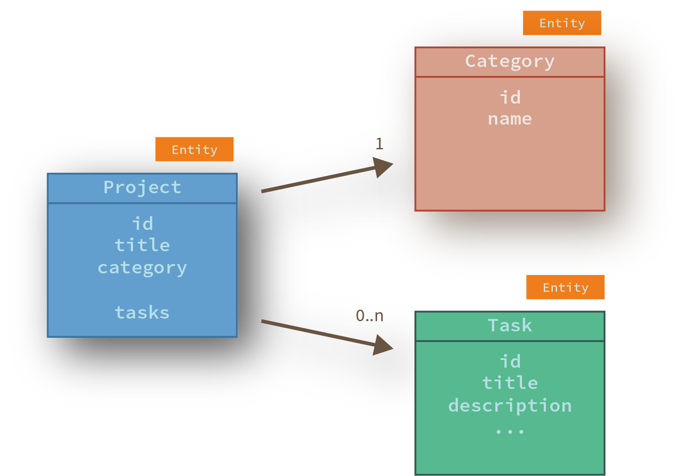
Database access
Database Access: Our (JPA-)Model

Slide 146
Database access
Accessing the database: An example query...
query {
projects {
title
category { name }
}
}
Question: How do we map relation Project-Category? Lazy? Eager? 🤔
What would happen in one or the other case?

Slide 147
Database access
Accessing the database: Another example query...
query {
projects {
title
tasks { id title }
}
}
Question: How do we map relation Project-Task? Lazy? Eager? 🤔
What would happen in one or the other case?

Slide 148
Database access
Accessing the database: An third query...
query {
projects {
title
tasks { id title }
category { name }
}
}
Question: what should we do?! 🤔

Slide 149
Database access
Accessing the database
We need optimized database SQL queries based on your concrete GraphQL Query!
// Bestehender DataFetcher
public DataFetcher<List<Project>> projectsFetcher = new DataFetcher<>() {
public Iterable<Project> get(DataFetchingEnvironment env) {
// 👉 TODO: Optimize based on the actual query
return projectRepository.findAll();
}
};
}
What Information do we need here?

Slide 150
Selection Set
SelectionSet: Contains all requested fields of a Query
Access via DataFetchingEnvironment
We can use the information provided to dynmically construct SQL/JPA/... database queries
Again: this examples are opionionated, you can use the SelectionSet also in other ways
public DataFetcher<Iterable<Project>> projects = new DataFetcher<>() {
public Iterable<Project> get(DataFetchingEnvironment env) throws Exception {
boolean withCategory = env.getSelectionSet().contains("category");
boolean withTasks = env.getSelectionSet().contains("tasks");
return projectRepository.findAll(withCategory, withTasks);
}
};

Slide 151
Database access
SelectionSet: Optimice Database Acccess
Example: JPA FetchGraph
public class ProjectRepository {
public List<Project> findAll(boolean withCategory, boolean withTasks) {
EntityGraph<Project> entityGraph = entityManager.createEntityGraph(Project.class);
if (withCategory) {
entityGraph.addSubgraph("category");
}
if (withTasks) {
entityGraph.addSubgraph("tasks");
}
TypedQuery<Project> query = em.createQuery("SELECT p FROM Project p", Project.class);
query.setHint("javax.persistence.fetchgraph", entityGraph);
return query.getResultList();
}
}
Modify JPA fetch behaviour based on
the actual needed data

Slide 152
Database access
SelectionSet: Optimize DB access with JPA FetchGraph
Example
👉 console
query {
projects @useEntityGraph {
title
tasks { id title }
category { name }
}
}

Slide 153
Summary
Determining data in graphql-java
For any field there is a DataFetcher (Default: PropertyDataFetcher)
DataFetcher can work asynchronously (by returning a CompletableFuture)
Using a DataLoader can reduce (remote) calls with caching and batching
With a SelectionSet per-query optimizations are possible (for example optimized database queries)

Slide 154
Outlook: graphql-java-tools

Slide 155
GraphQL-java-tools
graphql-java-tools
https://www.graphql-java-kickstart.com/tools/
Abstraction, based on graphql-java
Use POJOs for Data Resolvers

Slide 156
graphql-java-tools
Resolvers with graphql-java-tools
Resolvers are simple POJOs, Schema defined with SDL
Checks on application startup if all required resolvers are found
👉 backend_tools: (http://localhost:5100)
👉 Add ping to schema
👉 what happens when we start?
👉 and implement resolver-Method in QueryResolver
👉 Add assignee to Task and implement Resolver in TaskResolver

Slide 157
graphql-java-tools
Resolver with graphql-java-tools
Example: a query resolver
GraphQLQueryResolver is only a marker interface
public class ProjectAppQueryResolver implements GraphQLQueryResolver { // Methods on resolver classes must match field names in the schema
// GraphQL field arguments are passed as method arguments
public String ping(String msg) {
return "Hello, " + msg;
}
// You can still access graphl-java's DataFetchingEnvironment
public List<Project> projects(DataFetchingEnvironment env) {
boolean withCategory = ...; boolean withTasks = ...;
return beerRepository.findAll(withCategory, withTasks); } }

Slide 158
graphql-java-tools
Resolver with graphql-java-tools
Complex arguments (GraphQL input types) are deserialized to POJO instances and passed to your resolver method
public class AddTaskInput {
private String title;
private String description;
...
}
public class ProjectAppMutationResolver implements GraphQLMutationResolver { public Task addTask(String projectId, AddTaskInput input) {
return taskService.createTask(projectId, input);
}
}

Slide 159
graphql-java-tools
Resolver with graphql-java-tools
Resolvers for fields not on root types are typed with their Java types
The parent object (getSource in graphql-java) will be passed as first method parameter
public class ProjectResolver implements GraphQLResolver<Project> { public User getOwner(Project parent) {
return userService.getUser(parent.getOwnerId());
}
}

Slide 160
graphql-java-tools for Spring Boot
Spring Boot Starter
https://github.com/graphql-java-kickstart/graphql-spring-boot

Slide 161
graphql-java-tools for Spring Boot
Spring Boot Starter
https://github.com/graphql-java-kickstart/graphql-spring-boot
Merges automatically all Schema-Files in classpath (*.graphqls)
Resolver classes that are annotated as Spring Beans (for example @Component) are automatically recognized
Configuration of GraphQL servlet via application.properties
GraphiQL or Playground can be activated and configured by properties

Slide 162
Schema Design
Schema Design
There is room for improvement in our schema
We will discuss this only, technically there is nothing new (GraphQL related)

Slide 163
Schema Design
Do you see potential problems with our schema ?
type User { id: ID! login: String! name: String! } type Project { id: ID! title: String! description: String! owner: User! category: Category!
tasks: [Task!]!
task(id: ID!): Task } type Category { id: ID! name: String! }
enum TaskState {
NEW RUNNING FINISHED }
type Task { id: ID! title: String!
description: String!
state: TaskState!
assignee: User!
toBeFinishedAt: String! }
type Query { users: [User!]!
projects: [Project!]!
project(id: ID!): Project
}
input AddTaskInput { title: ID! description: ID! toBeFinishedAt: String assigneeId: ID! }
type Mutation { addTask(project: ID!, input: AddTaskInput!):
Task!
updateTaskState(taskId: ID!, newState: TaskState!):
Task! }
Lists: no filtering, sorting, pagination!

Slide 164
Schema Design
Do you see potential problems with our schema ?
type User { id: ID! login: String! name: String! } type Project { id: ID! title: String! description: String! owner: User! category: Category!
tasks: [Task!]!
task(id: ID!): Task } type Category { id: ID! name: String! }
enum TaskState {
NEW RUNNING FINISHED }
type Task { id: ID! title: String!
description: String!
state: TaskState!
assignee: User!
toBeFinishedAt: String! }
type Query { users: [User!]!
projects: [Project!]!
project(id: ID!): Project
}
input AddTaskInput { title: ID! description: ID! toBeFinishedAt: String assigneeId: ID! }
type Mutation { addTask(project: ID!, input: AddTaskInput!):
Task!
updateTaskState(taskId: ID!, newState: TaskState!):
Task! }
Error Handling: what do we do, when something goes wrong?

Slide 165
Schema Design
Do you see potential problems with our schema ?
type User { id: ID! login: String! name: String! } type Project { id: ID! title: String! description: String! owner: User! category: Category!
tasks: [Task!]!
task(id: ID!): Task } type Category { id: ID! name: String! }
enum TaskState {
NEW RUNNING FINISHED }
type Task { id: ID! title: String!
description: String!
state: TaskState!
assignee: User!
toBeFinishedAt: String! }
type Query { users: [User!]!
projects: [Project!]!
project(id: ID!): Project
}
input AddTaskInput { title: ID! description: ID! toBeFinishedAt: String assigneeId: ID! }
type Mutation { addTask(project: ID!, input: AddTaskInput!):
Task!
updateTaskState(taskId: ID!, newState: TaskState!):
Task! }
Security: is the user allowed to add a new Task?

Slide 166
Schema Design
Do you see potential problems with our schema ?
How could we improve? Dou you have ideas?
type User { id: ID! login: String! name: String! } type Project { id: ID! title: String! description: String! owner: User! category: Category!
tasks: [Task!]!
task(id: ID!): Task } type Category { id: ID! name: String! }
enum TaskState {
NEW RUNNING FINISHED }
type Task { id: ID! title: String!
description: String!
state: TaskState!
assignee: User!
toBeFinishedAt: String! }
type Query { users: [User!]!
projects: [Project!]!
project(id: ID!): Project
}
input AddTaskInput { title: ID! description: ID! toBeFinishedAt: String assigneeId: ID! }
type Mutation { addTask(project: ID!, input: AddTaskInput!):
Task!
updateTaskState(taskId: ID!, newState: TaskState!):
Task! }

Slide 167
Pagination
GraphQL doesn't say anthing about pagination, ordering,...
Two approaches:Page-based or cursor-based
Example: Page-based
type Query { projects(
page: Int!,
pageSize: Int!): ProjectList!
}
type ProjectList {
page: Int!
totalElements: Int!
hasNext: Boolean!
hasPrev: Boolean!
projects: [Project!]!
}

Slide 168
Paginierung
GraphQL doesn't say anthing about pagination, ordering,...
Simplified example with Spring Data
import org.springframework.data.domain.Page;
import org.springframework.data.domain.PageRequest;
public class ProjectQueryResolver implements
GraphQLQueryResolver {
@Inject private ProjectRepository projectRepository; public ProjectList projects(int page, int pageSize) {
Page<Project> page = projectRepository.find(
PageRequest.of(page, pageSize)
);
return new ProjectList(
page.getNumber(),
page.getTotalElements(),
page.hasNext(), page.hasPrevious(),
page.getContent()
);
}
}
type Query { projects(
page: Int!,
pageSize: Int!): ProjectList!
}
type ProjectList {
page: Int!
totalElements: Int!
hasNext: Boolean!
hasPrev: Boolean!
projects: [Project!]!
}

Slide 169
Paginierung
GraphQL doesn't say anthing about pagination, ordering,...
Ordering also using own fields or arguments
=> not comparable to out-of-the-box-power of SQL, you have to make sure that your API works as desgined...
enum Direction {
asc, desc
}
type ProjectOrderCriteria {
field: String!
direction: Direction!
}
type Query { projects(
page: Int!,
pageSize: Int!,
orderBy: ProjectOrderCriteria
) : ProjectList!
}
query {
projects(page: 1,
pageSize: 20,
orderBy(field: "title", direction: asc)
) {
hasNext
projects {
id
title
}
}
}
}

Slide 170
Security
GraphQL doesn't say anything about security

Slide 171
Security
GraphQL doesn't say anything about security
Question 1: is your api public or not? Do you want user to be logged in to use your api?
Example with Spring Security: Secure your /graphql endpoint
@Configuration
public class SecurityConfiguration extends WebSecurityConfigurerAdapter {
protected void configure(HttpSecurity http) throws Exception {
http.authorizeRequests()
.antMatchers("/graphql").authenticated();
}
}

Slide 172
Security
GraphQL doesn't say anything about security
You can secure your business logic as usual
Example: Spring Security (would be similiar with JEE)
public class TaskMutationResolver implements
GraphQLMutationResolver { private TaskRepository taskRepository;
@PreAuthorize(
"isAuthenticated()"
)
public Task addTask(AddTaskInput newTask) {
Task task = Task.from(newTask); taskRepository.save(task);
return task; } }
type Mutation { addTask
(taskInput:
TaskInput!):
Task!
}

Slide 173
Security
Schema Directives
Directives are similiar to Annotations in Java
They can be specified in a schema for the Schema itself or with usage in Operations
You could write a directive and process it in your application
directive @adminOnly on FIELD_DEFINITION
type Mutation { addTask @adminOnly (taskInput: TaskInput!): Task!
}

Slide 174
Security
GraphQL doesn't say anything about security
Errors would end up in 'errors'-Objekt
(You could customize the output of the errors object)

Slide 175
Error Handling
(Technical) Errors end up in the errors-object in your response
Business/domain errors could also be part of your schema (own type)

Slide 176
Error Handling
(Technical) Errors end up in the errors-object in your response
Business/domain errors could also be part of your schema (own type)
for example: validation errors
type Mutation { addTask (taskInput: TaskInput!): Task!
}
type Mutation { addTask(taskInput: TaskInput!): AddTaskResult!
}
type AddTaskResult {
newTask: Task
validationErrors: [ValidationError!]
}
type ValidationError {
field: String!
msg: String!
}

Slide 177
Error Handling
(Technical) Errors end up in the errors-object in your response
Business/domain errors could also be part of your schema (own type)
for example: validation errors
or as Union Type
union AddTaskResult = AddTaskSuccess | AddTaskFailure
type AddTaskSuccess {
newTask: Task
}
type AddTaskFailure {
validationErrors: [ValidationError!]
}
type Mutation { addTask(taskInput: TaskInput!): AddTaskResult
}
mutation addTask(taskInput: "...") {
...on AddTaskSuccess {
newTask { id title }
}
...on AddTaskFailure {
validationErrors: { msg }
}
}

Slide 178
Outlook
Q & A
Discussions

Slide 179
OUtlook
Do you have questions?
What should we look deeper into?

Slide 180
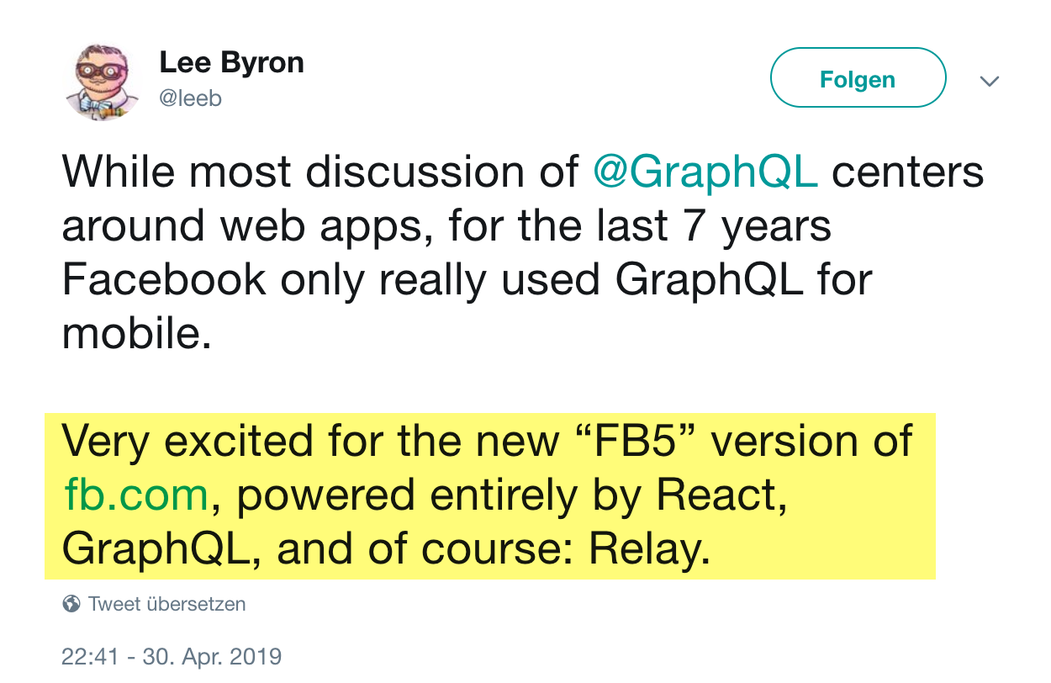
Facebook 5
https://twitter.com/leeb/status/1123326647552266241

Slide 181
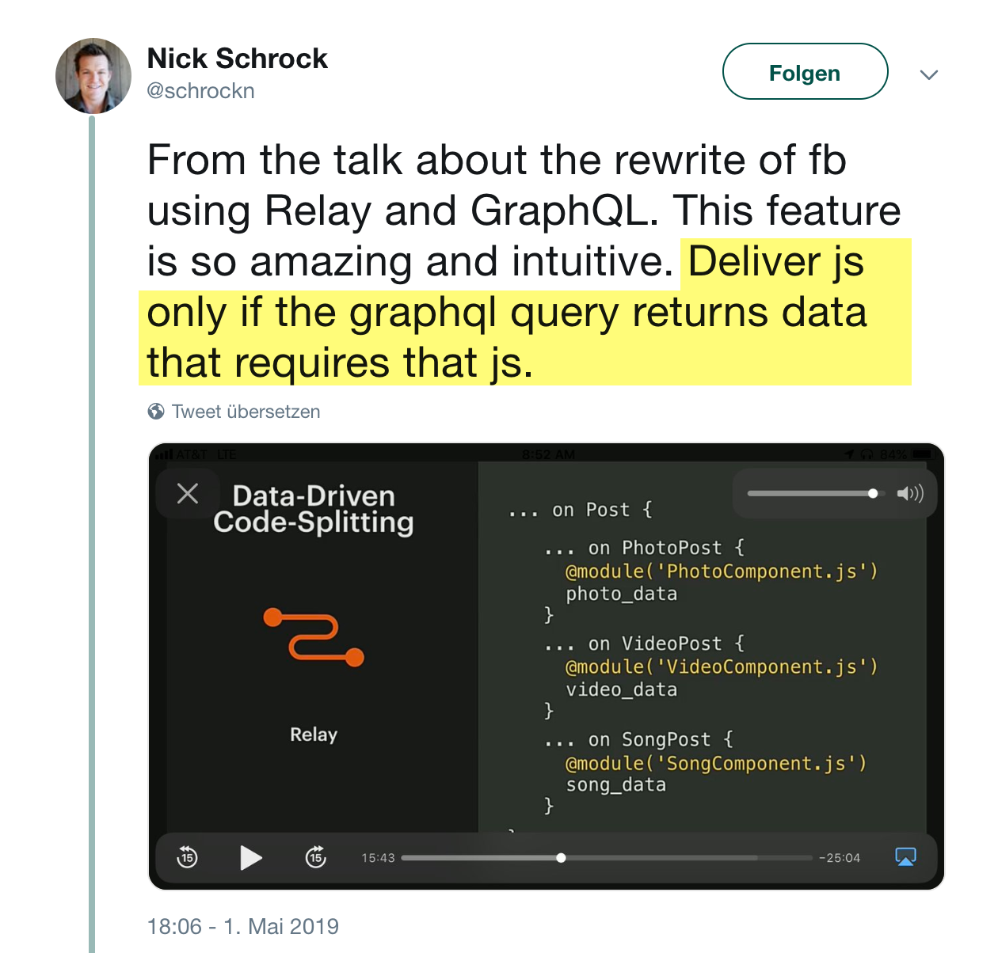
Next Gen GraphqL?
https://twitter.com/schrockn/status/1123619660732047360

Slide 182
HTTPS://NILSHARTMANN.NET | @nilshartmann
🌻
Thank you!
Repository: https://github.com/nilshartmann/graphql-java-workshop
Slides: https://react.schule/api-conf-graphql
Contact: nils@nilshartmann.net

